Slide 1
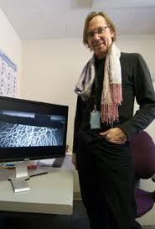
Supershear Earthquakes
Theory, Experiments & Observations
Harsha Suresh Bhat
M. Bouchon
U. Grenoble Alpes
A. Schubnel
ENS
A. J. Rosakis
Caltech
D. Kondo
Sorbonne U.
P. A. Johnson
Los Alamos
S. Das
Oxford U.
To obtain Habilitation à Diriger des Recherches from École Normale Supérieure

Slide 2
Classical View of an Earthquake
Tectonic plates try to slide past each around faults
The faults resist this motion due to friction
This builds up energy in the medium and increases stress on the faults
Once the stresses exceed frictional resistance the plates slide past each other as the fault ruptures (unzips)
This leads to a sudden release of the stored energy called an Earthquake
Video courtesy USGS

Slide 3
Rupture Speed
S-waves
P-waves
As the fault ruptures (unzips) it radiates Pressure-waves and Shear-waves into the medium
Thus, three different speeds come into action
rupture speed
S-wave speed (~3.5 km/s)
P-wave speed (~5 km/s)
A vast majority of earthquakes have rupture speed slower than the S-wave speed, around 2.5 km/s to 3 km/s
Such class of earthquakes are called subshear earthquakes
Fault
Rupture Front

Slide 4
Rupture Speed
However, occasionally, the rupture tends to go faster than the S-wave speed (but slower than the P-wave speed)
Such class of earthquakes are called Supershear Earthquakes

Slide 5
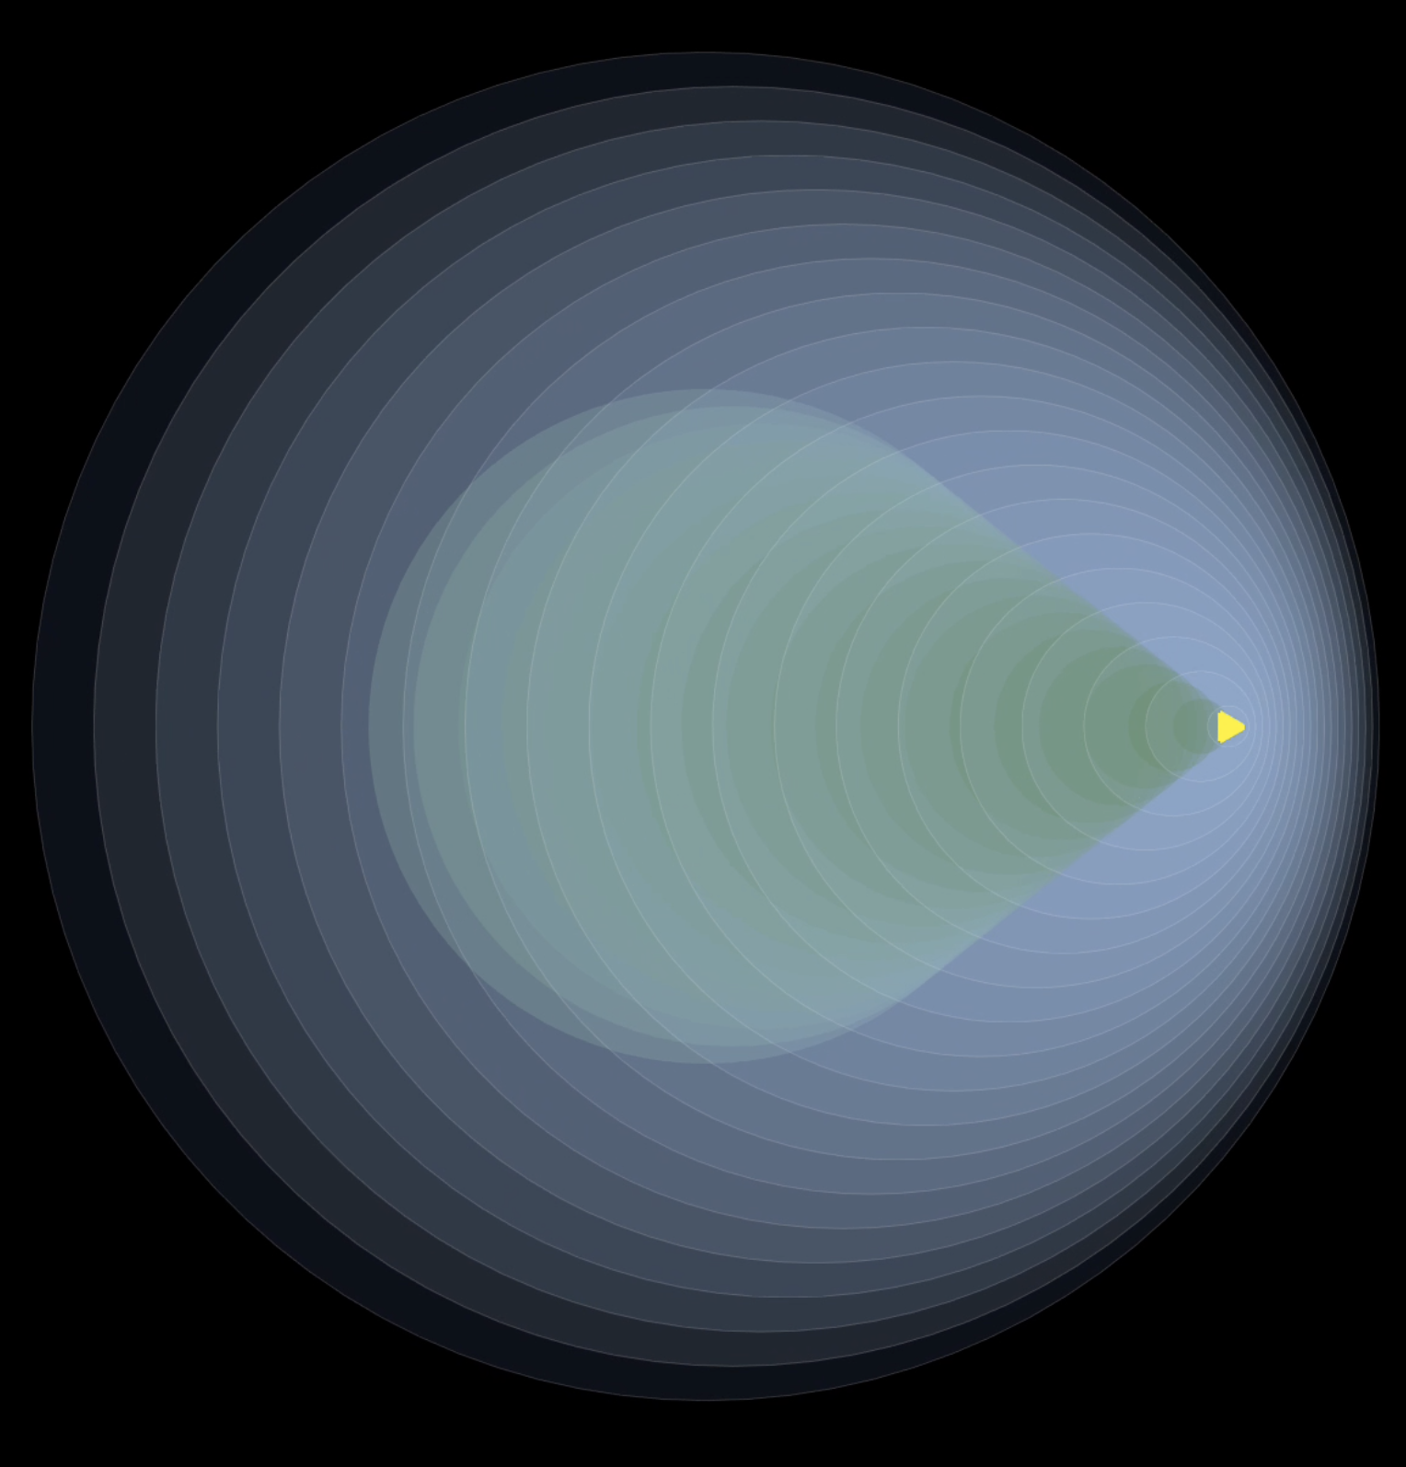
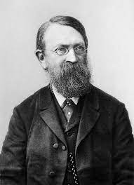
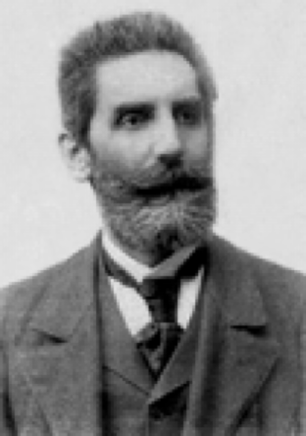
Supersonic Supershear
Shock / Mach Front
E. Mach
P. Salcher
https://www.nasa.gov/image-feature/stark-beauty-of-supersonic-shock-waves
Photographische Fixirung der durch Projectile in der Luft eingeleiteten Vorgänge," Sitzungsber. k. Akad. Wiss., math.-naturwiss. Classe, 95 (1887) 764-80

Slide 6
Supershear Earthquakes
Theory, Experiments & Observations
Jara, J., L. Bruhat, S. Antoine, K. Okubo, M. Y. Thomas, Y. Klinger, R. Jolivet, and H. S. Bhat (2021). “Signature of supershear transition seen in damage and aftershock pattern”. to be subm.
Amlani, F., H. S. Bhat, W. J. F. Simons, A. Schubnel, C. Vigny, A. J. Rosakis, J. Efendi, A. Elbanna, and H. Z. Abidin (2021). “Supershear Tsunamis and insights from the Mw 7.5 Palu Earthquake”. to be subm.
Mello, M., H. S. Bhat, and A. J. Rosakis (2016). “Spatiotemporal properties of sub-Rayleigh and supershear rupture velocity fields : Theory and Experiments”. J. Mech. Phys. Solids. DOI: 10.1016/j. jmps.2016.02.031.
Mello, M., H. S. Bhat, A. J. Rosakis, and H. Kanamori (2014). “Reproducing The Supershear Portion Of The 2002 Denali Earthquake Rupture In Laboratory”. Earth Planet. Sc. Lett. DOI: 10.1016/j.epsl. 2013.11.030.
Passelègue, F. X., A. Schubnel, S. Nielsen, H. S. Bhat, and R. Madariaga (2013). “From Sub-Rayleigh to Supershear Ruptures During Stick-Slip Experiments on Crustal Rocks”. Science. DOI: 10.1126/ science.1235637.
Dunham, E. M. and H. S. Bhat (2008). “Attenuation of radiated ground motion and stresses from three-dimensional supershear ruptures”. J. Geophys. Res. DOI: 10.1029/2007JB005182.
Bhat, H. S., R. Dmowska, G. C. P. King, Y. Klinger, and J. R. Rice (2007). “Off- fault damage patterns due to supershear ruptures with application to the 2001 Mw 8.1 Kokoxili (Kunlun) Tibet earthquake”. J. Geophys. Res. DOI: 10.1029/2006JB004425.

Slide 7
Theory
Earthquake ruptures modelled as dynamic shear fractures
Craggs (1960) : Solution for a steady state semi-infinite crack, subjected to combined mode I and mode II loading
Stable crack growth possible if energy from the surrounding linear elastic field is drawn into the crack tip
Only possible if rupture speed below the Rayleigh wave speed
Kostrov (1964) : Self-similar solution of a propagating shear crack
Energy will be radiated out from the crack tip if the rupture speed lies between the Rayleigh and shear wave speeds of the surrounding linear elastic medium. Thus forbidden.
Mode II shear crack will tend to propagate in the sub-Rayleigh rupture speed regime
Weertman (1969) : Treated the crack as smeared-out dislocations
Supershear velocity is forbidden
0
Rayleigh
Shear
Pressure

Slide 8
Theory
Earthquake ruptures modelled as dynamic shear fractures
Burridge (1973) : Solution for a self-similar mode II crack
Showed how to by-pass the forbidden speed regime
A peak in the shear stress propagates ahead of the crack front at the S-wave speed nucleating a secondary (supershear) rupture ahead
Hamano (1974) : Numerical solution of rupture propagation
Propagation velocity increases monotonically up to the P-wave speed
Andrews (1976) : Numerically simulated a sub-Rayleigh to supershear rupture transition
Validated Burridge mechanism of bypassing forbidden regime
Identified mechanically stable portion of the supershear rupture speed regime
Introduced the notion of a 'transition' length
0
Rayleigh
Shear
$$\sqrt{2}$$
Pressure

Slide 9
Theory
Earthquake ruptures modelled as dynamic shear fractures
Das (1976) , Das & Aki (1977) : Numerically simulated a sub-Rayleigh to supershear rupture transition
Introduced the 𝑆 - ratio , a non-dimensional measure of the strength of a fault
Showed that for 𝑆 ≤ 1.77 results in supershear rupture
Burridge (1979) : Stability analysis of a steady-state shear crack driven by a point load
Verified the various admissible speed regimes
Freund (1979) : Solutions for the stress and particle velocities due to a 2D steady state shear crack
Stability of sub-shear crack propagation
0
Rayleigh
Shear
$$\sqrt{2}$$
Pressure

Slide 10
Theory
2D Steady State Singular Elastic Model : Sub-Rayleigh
Mello, Bhat et al. 2016

Slide 11
Theory
2D Steady State Singular Elastic Model : Supershear
Mello, Bhat et al. 2016

Slide 12
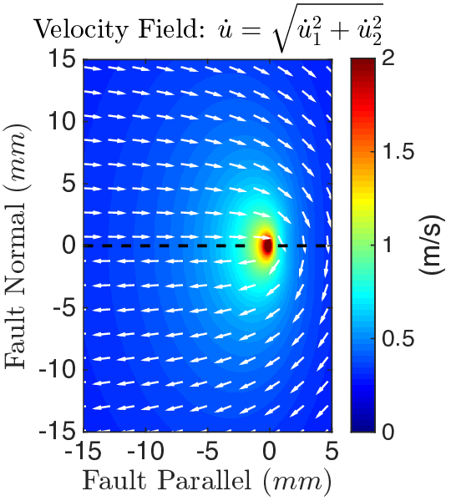
Theory
2D Steady State Singular Elastic Model : Supershear $\sqrt{2}c_{s}$ case
Eshelby 1949
Mello, Bhat et al. 2016

Slide 13
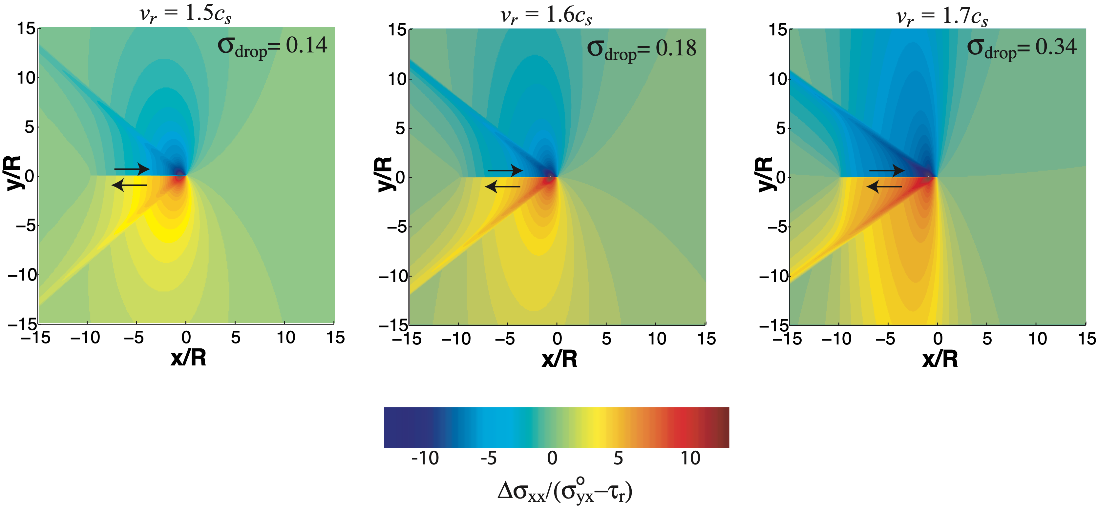
Theory
2D Steady State Cohesive Zone Model : Supershear Stress Field
Bhat et al. 2007

Slide 14
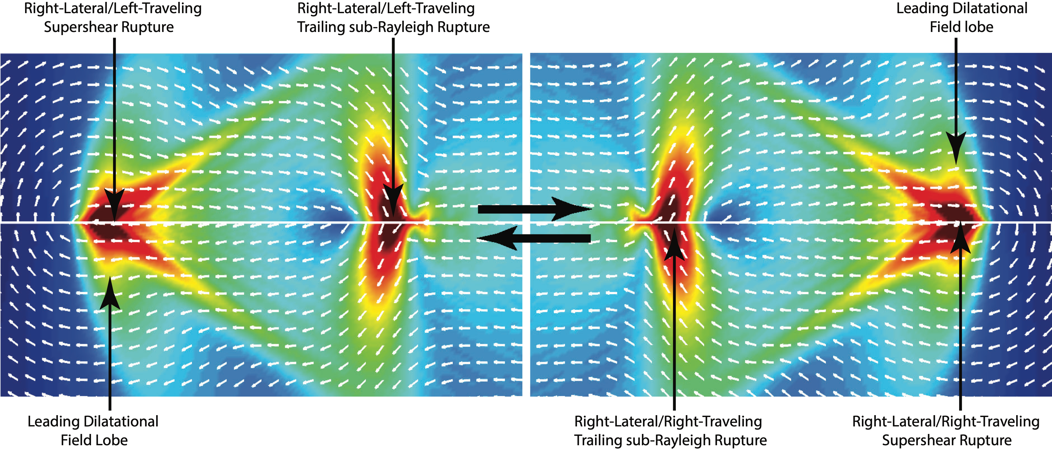
Theory
Mello, Bhat et al. 2016
2D Spontaneous Rupture Model : Supershear

Slide 15
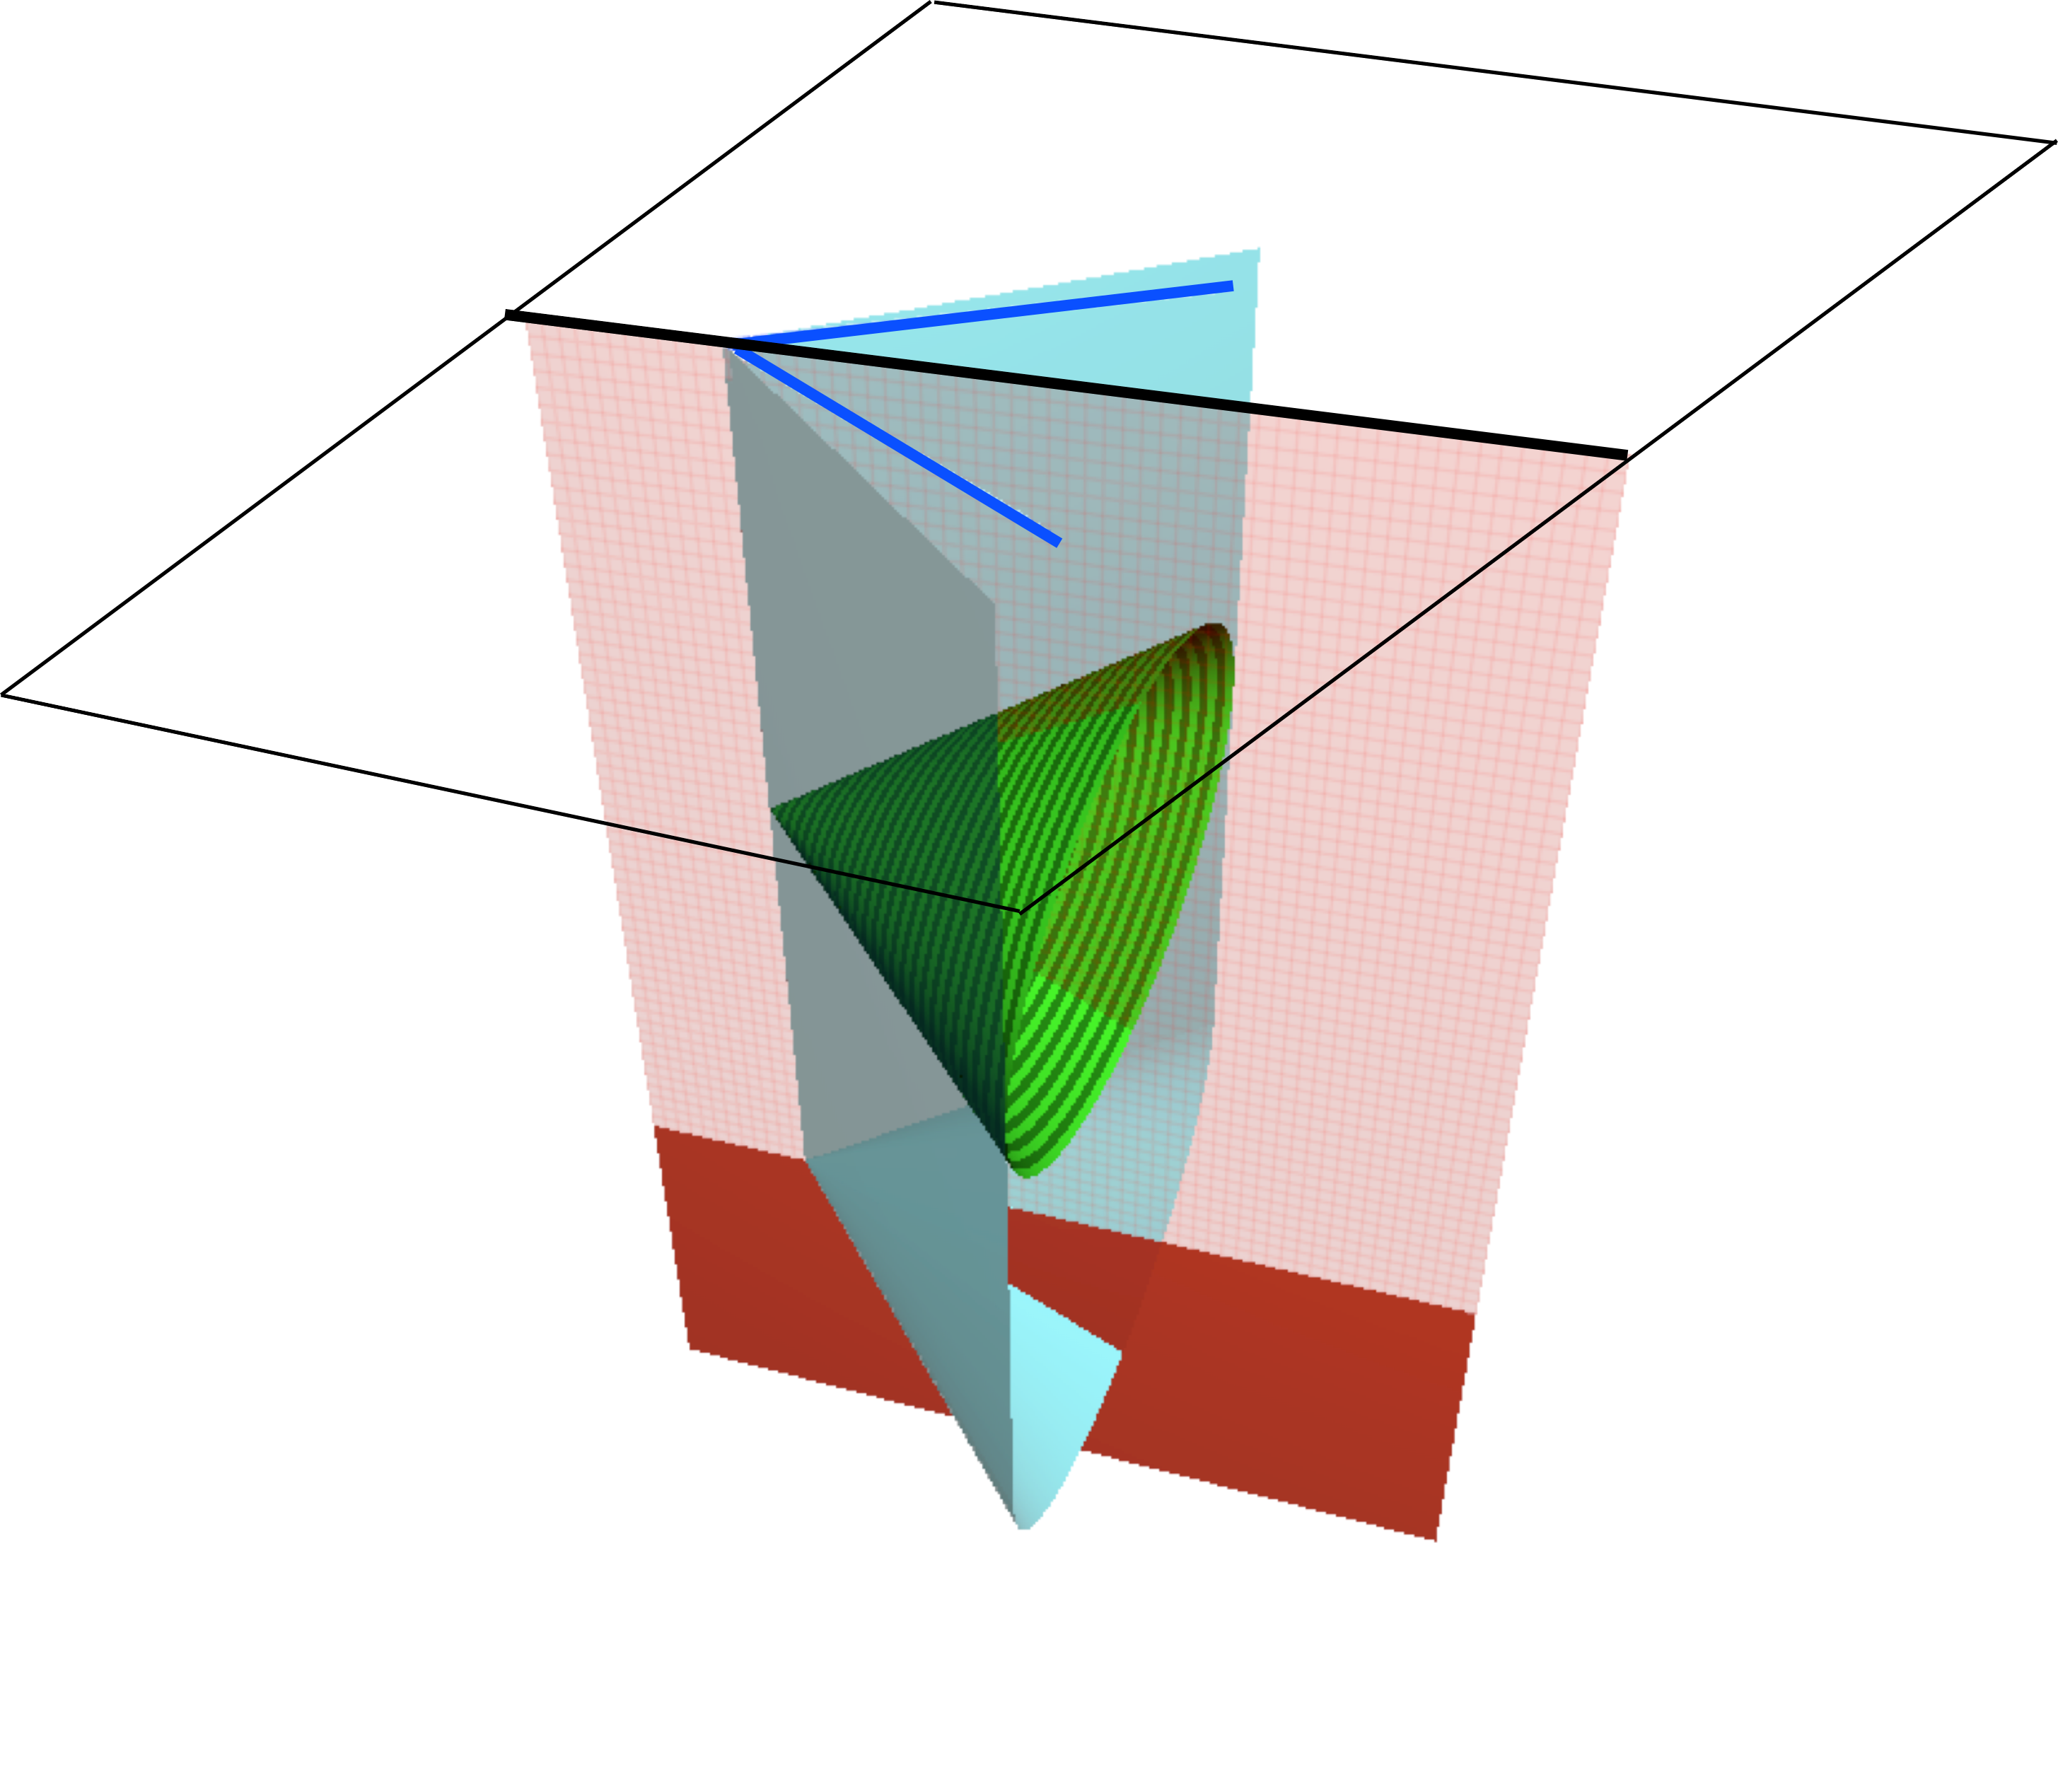
Theory
3D Steady State Cohesive Zone Model : Supershear
Slipping
Locked
Dunham & Bhat 2008

Slide 16
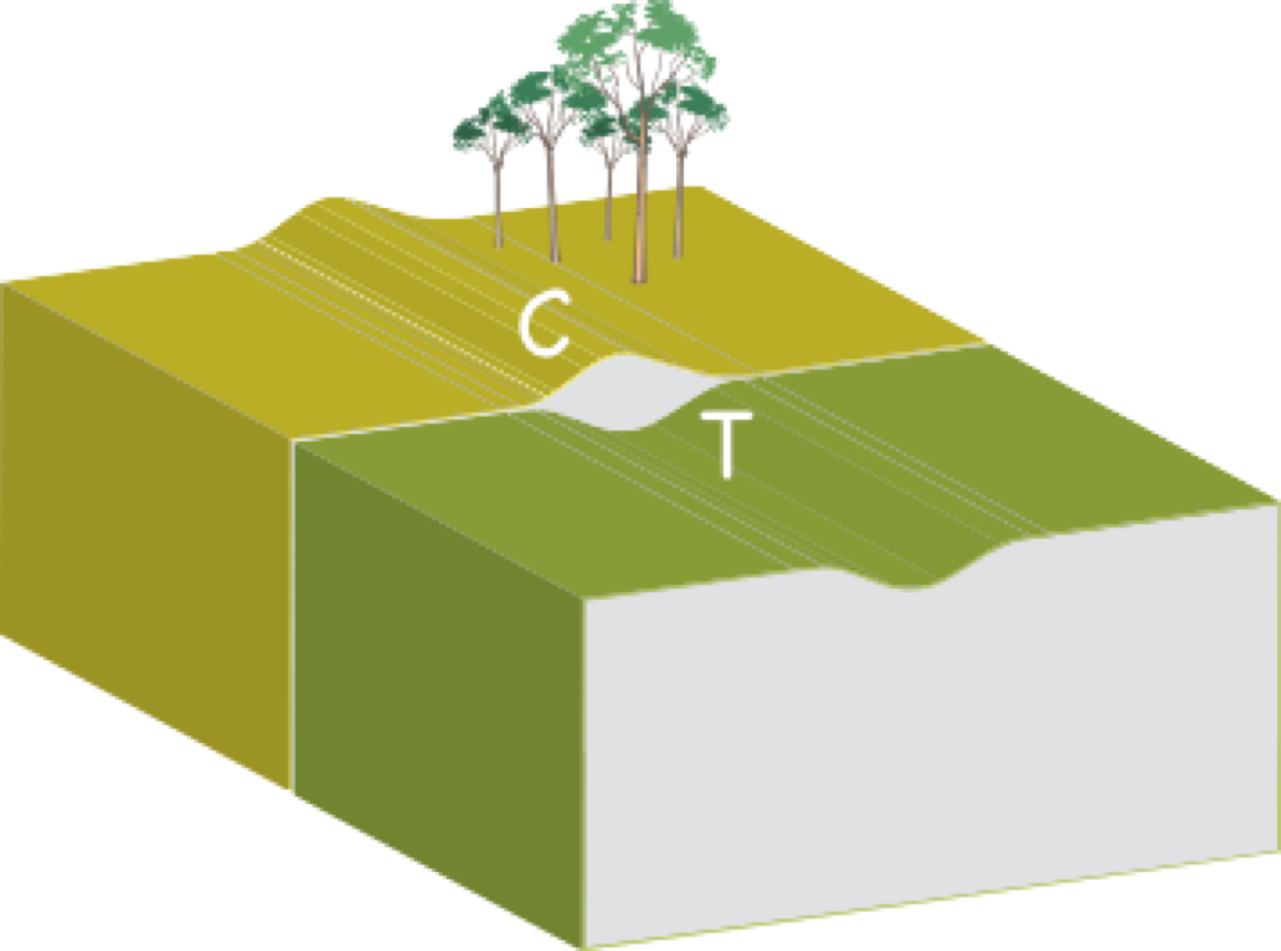
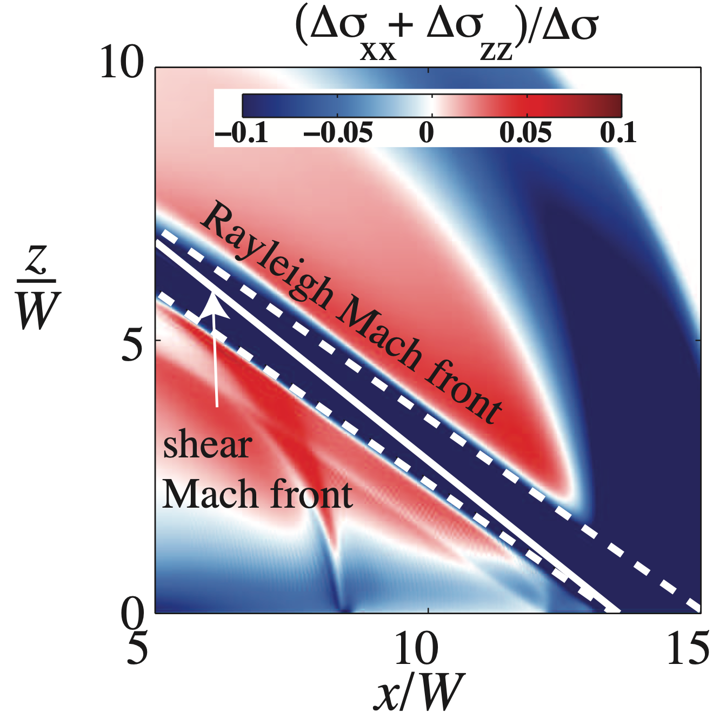
Theory
3D Steady State Cohesive Zone Model : Supershear
Rupture tip causes medium to bulge on the compressional side and dimple on the extensional side
To maintain the traction-free surface, Rayleigh waves are generated
If rupture is supershear => superRayleigh => Rayleigh Mach fronts
Dunham & Bhat 2008

Slide 17
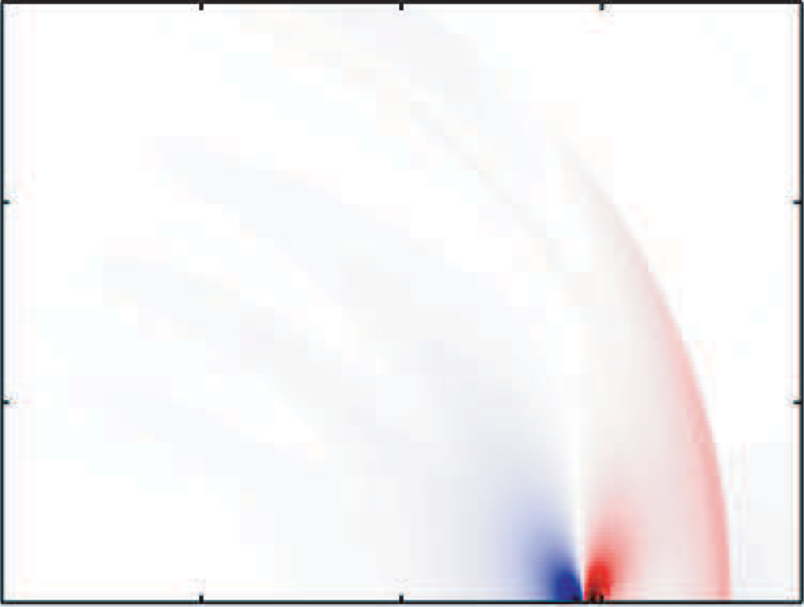
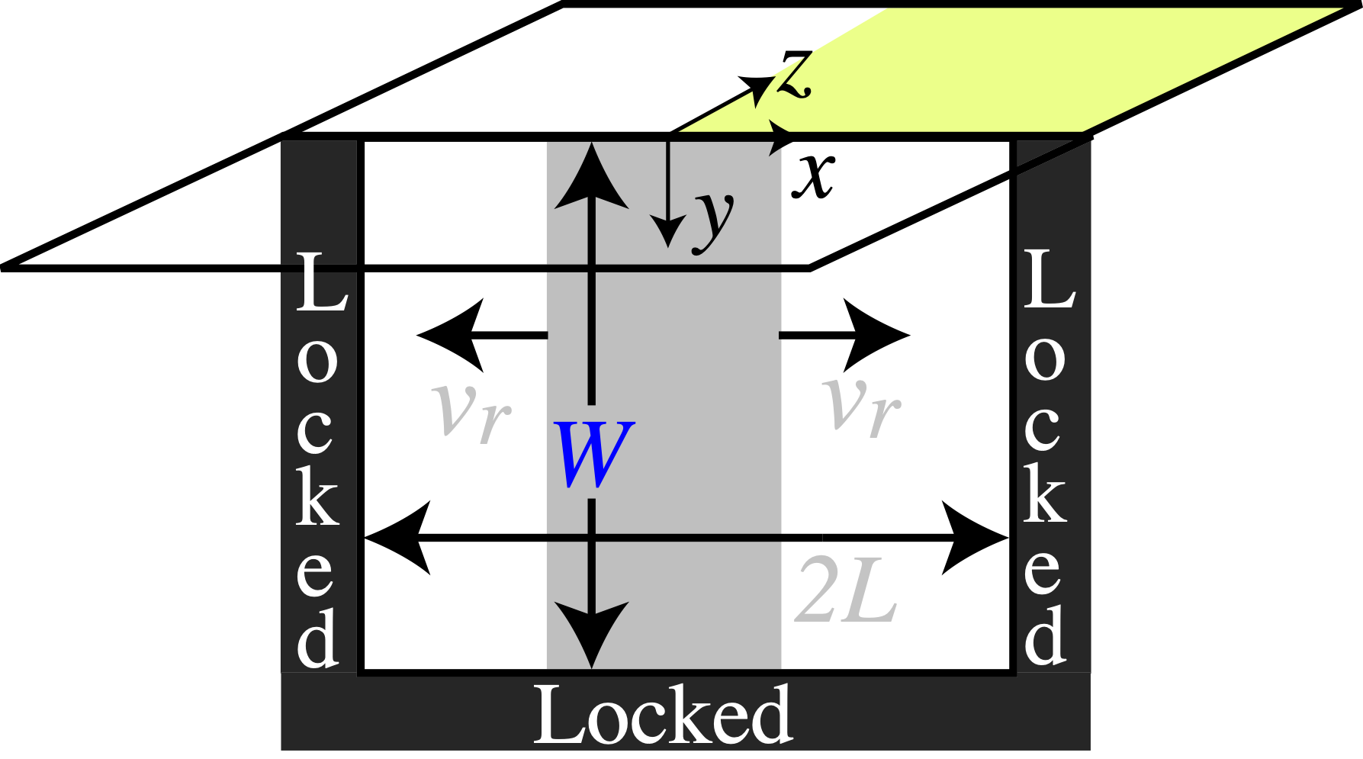
0
5W
10W
15W
150km
15W
Sub-Rayleigh Rupture
Fault Normal Velocity
100km
10W
50km
5W
0
0
0
50km
100km
150km
Dunham & Bhat 2008

Slide 18
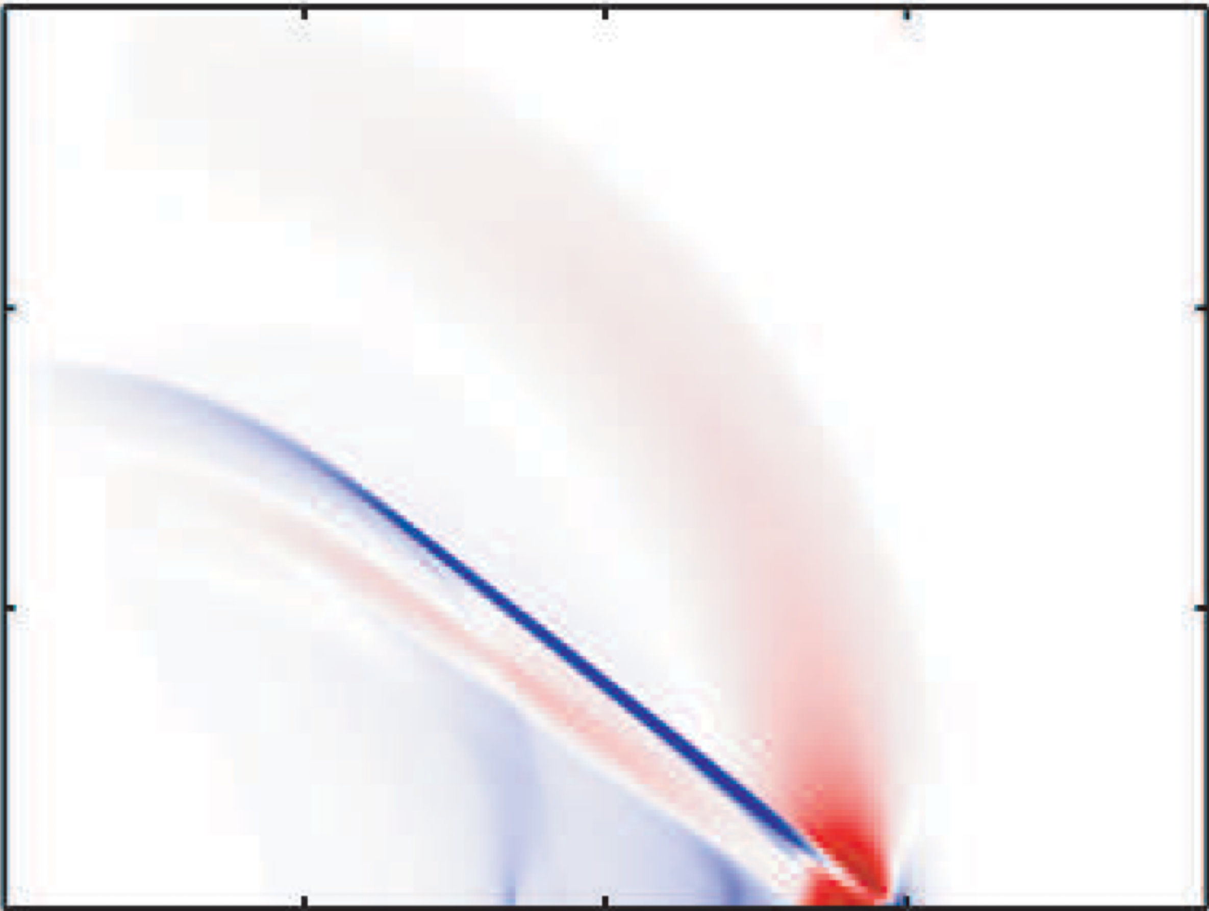
0
5W
10W
15W
150km
15W
Supershear Rupture
Fault Parallel Velocity
100km
10W
50km
5W
0
0
0
50km
100km
150km
Dunham & Bhat 2008

Slide 19
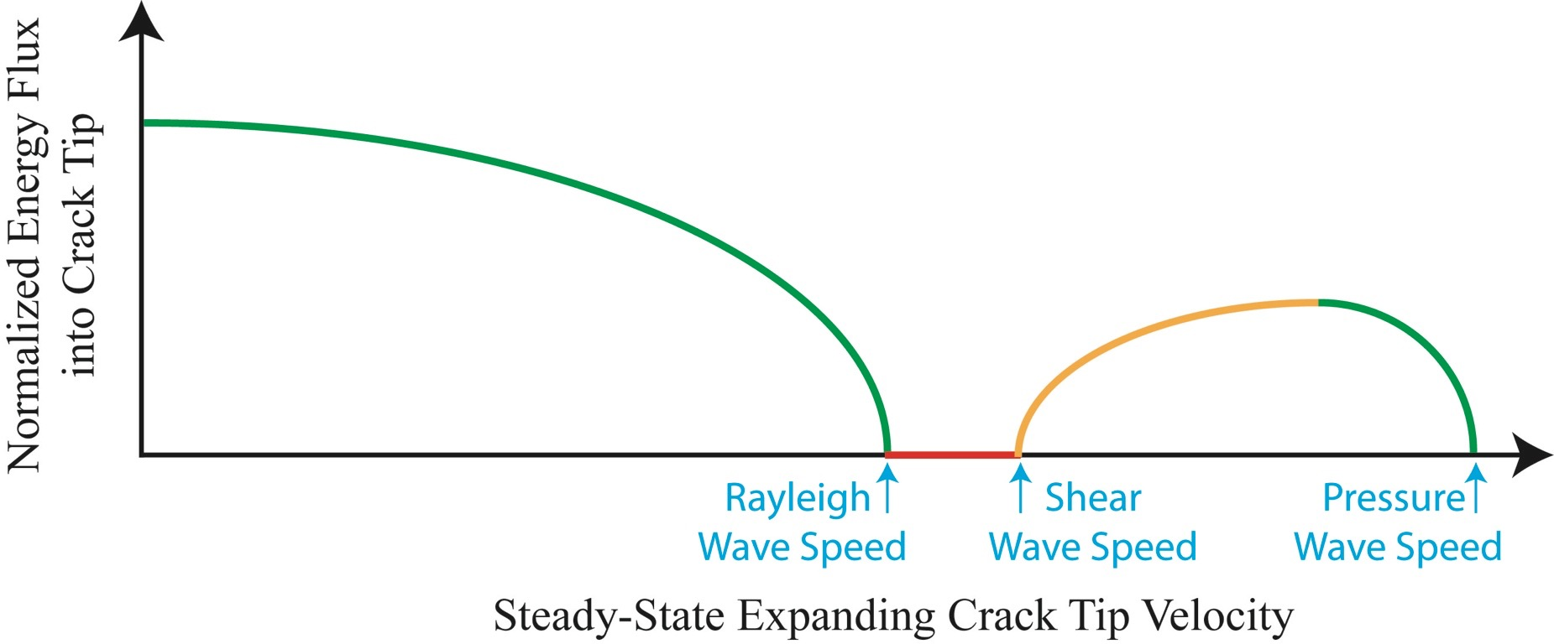
Theory
Sub to Supershear Transition
Burridge (1973) & Andrews (1976) : Mother-Daughter transition mechanism

Slide 20
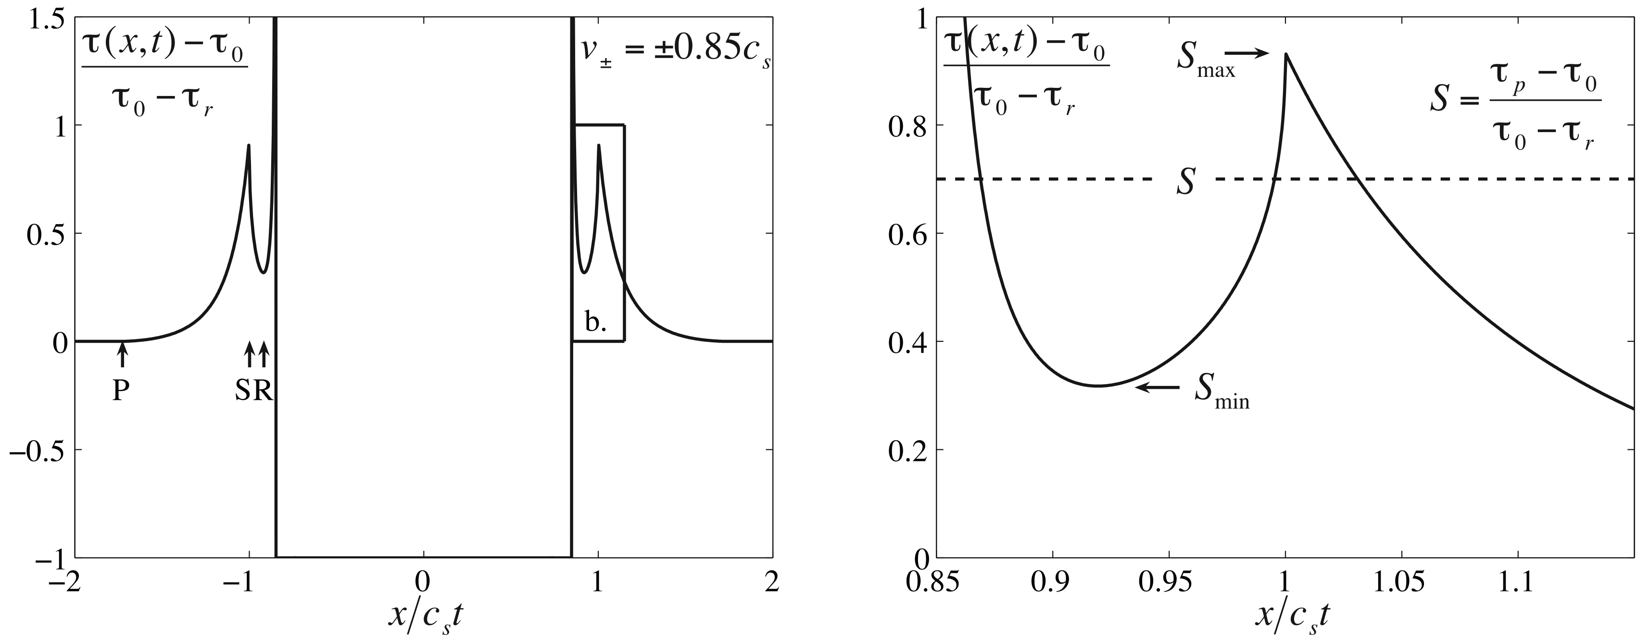
Theory
Sub to Supershear Transition
Burridge (1973) & Andrews (1976) : Mother-Daughter transition mechanism
Dunham 2007

Slide 21
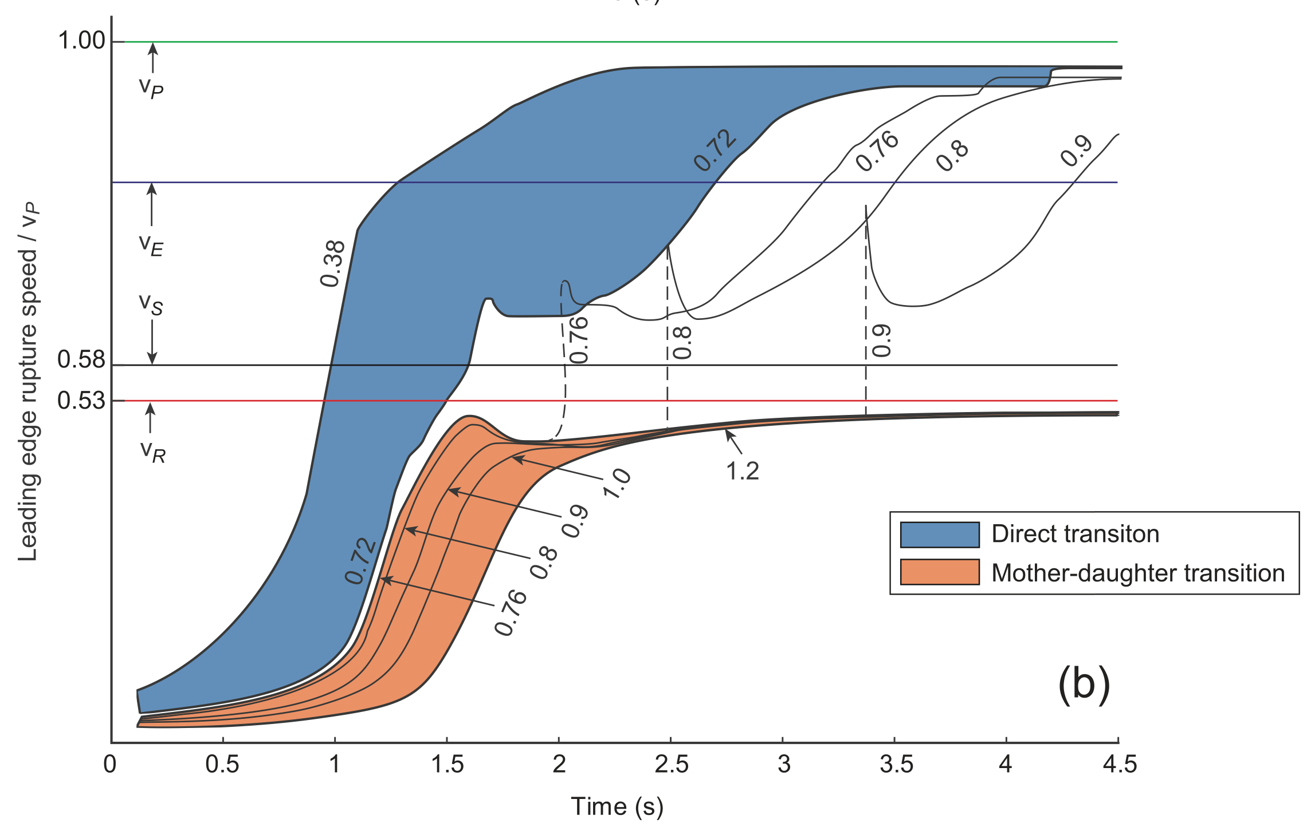
Theory
Sub to Supershear Transition
Bizzarri & Das (2012) & Liu et al. (2014) : Continuous transition possible under certain conditions
Liu et al 2014

Slide 22
Theory
Sub to Supershear Transition : Off-Fault Damage
Subshear
Transition
Supershear
Mohr-Coulomb Plasticity
Templeton & Rice 2008
Transition
Subshear
Supershear
Discrete Damage
Okubo et al 2019
Supershear
Subshear
Transition
Thomas & Bhat 2018
Continuum Damage
Jara, Bruhat et al. 2021

Slide 23
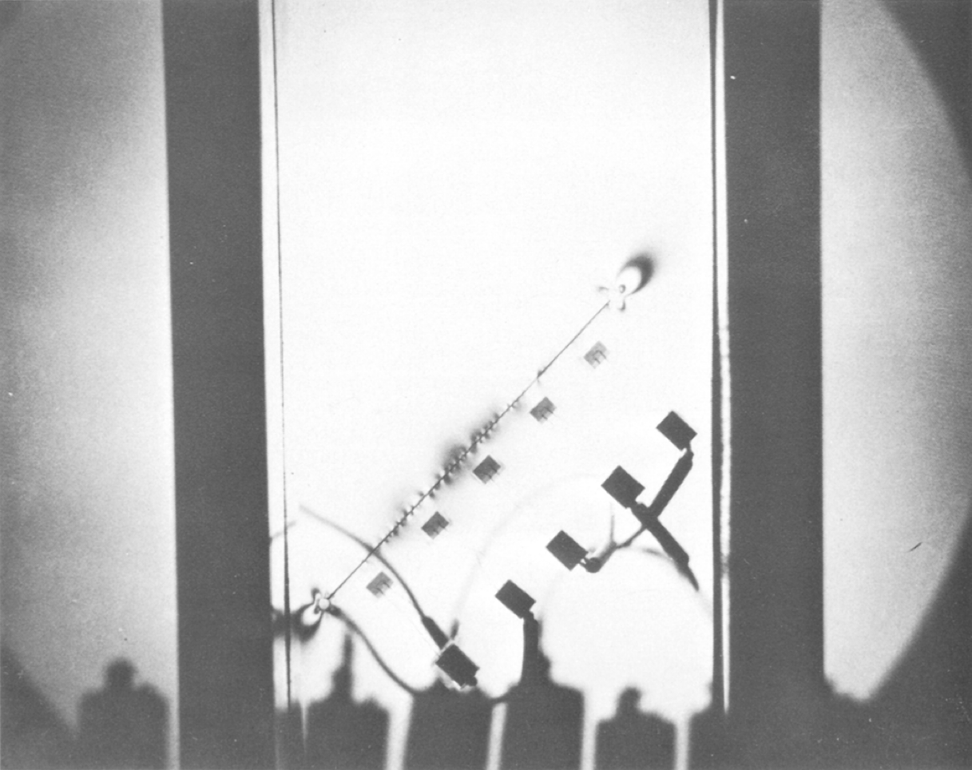
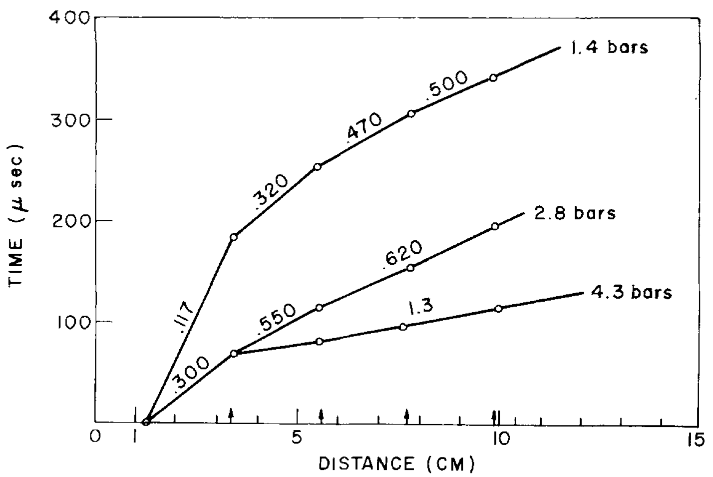
Experiments
Wu (1972) : Stick-Slip experiments in Columbia Resin
Supershear ~ 1.1cs
As Weertman (1969) theory disallowed supershear, it was forgotten. Probably!

Slide 24
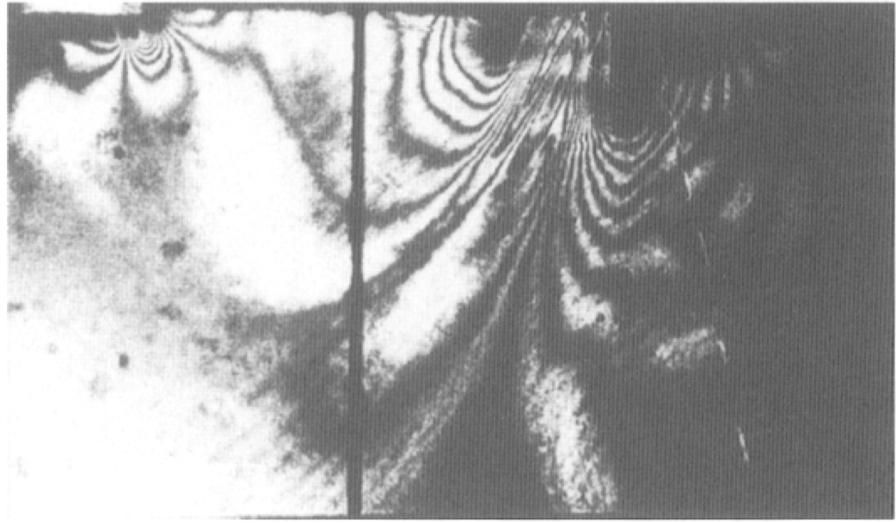
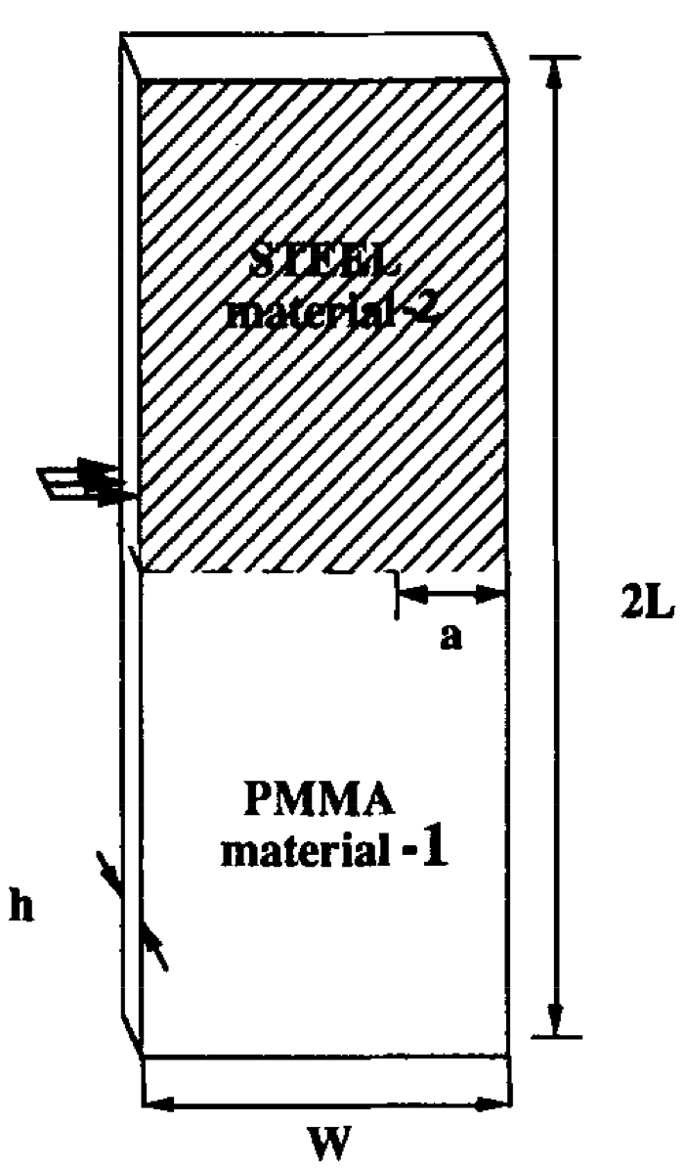
Experiments
Lambros & Rosakis (1995) : Bi-Material shear impact experiments
Projectile
First recorded image of a supershear rupture!

Slide 25
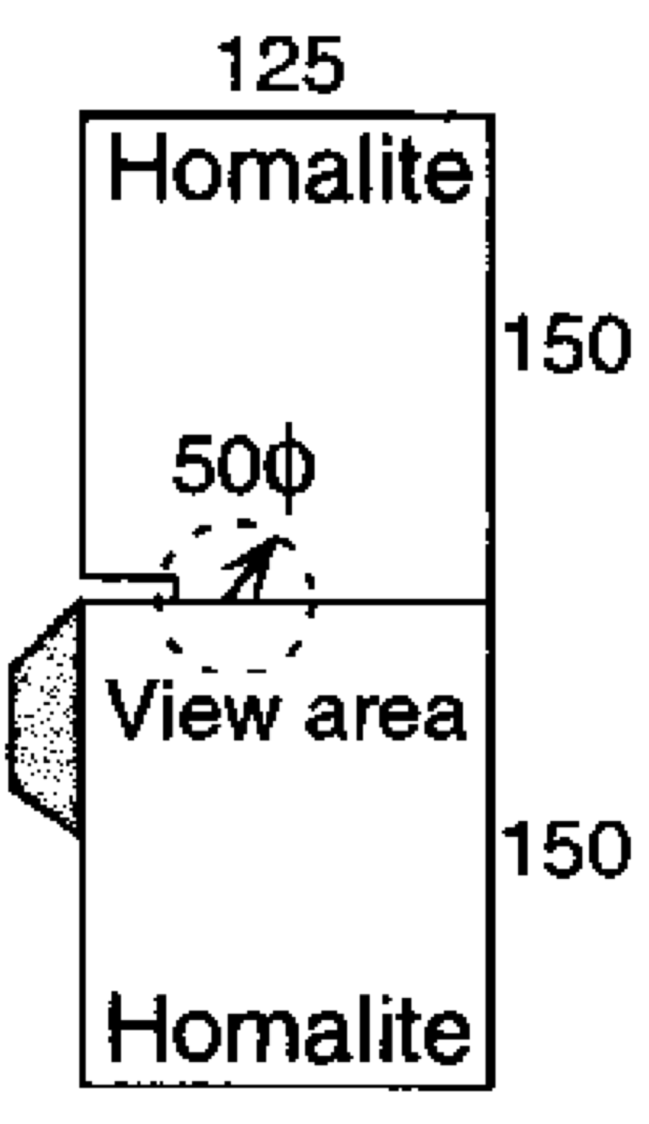
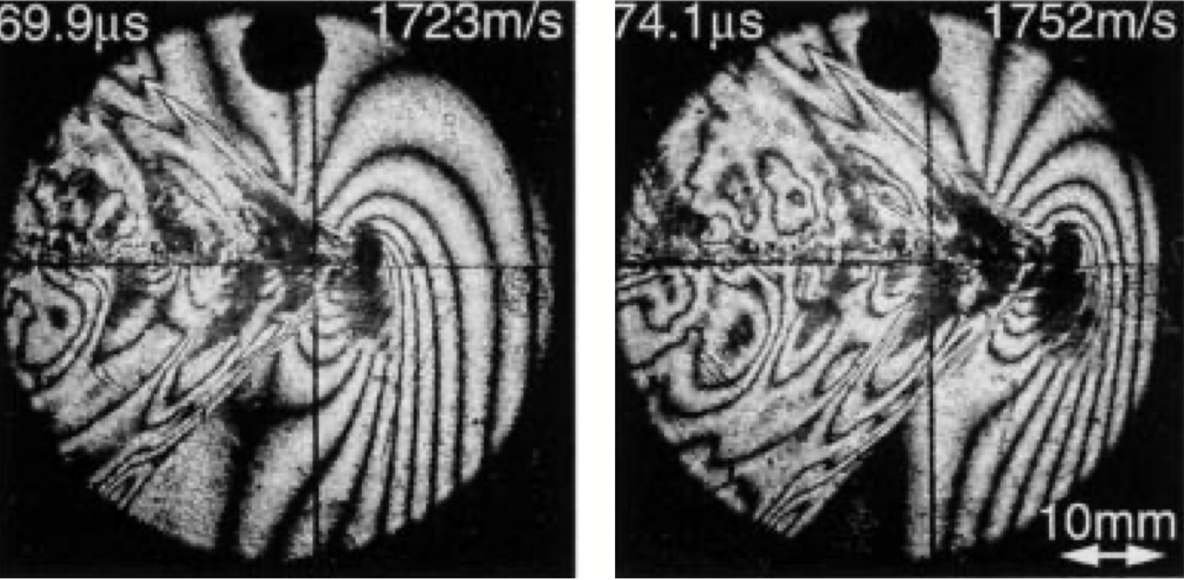
Experiments
Rosakis et al. (1999) : Shear impact experiments
Impact

Slide 26
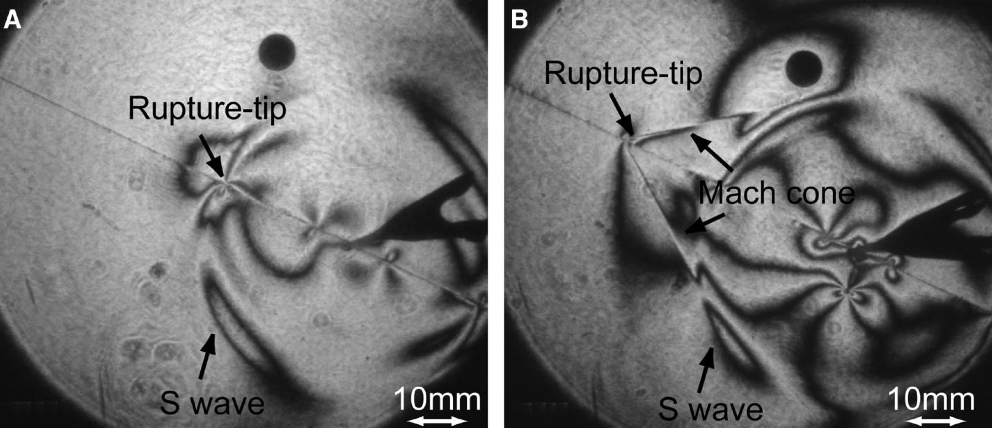
Experiments
Xia et al. (2004) : Spontaneous shear ruptures along a frictional interface a.k.a Laboratory Earthquakes
First laboratory evidence of Supershear Ruptures

Slide 27
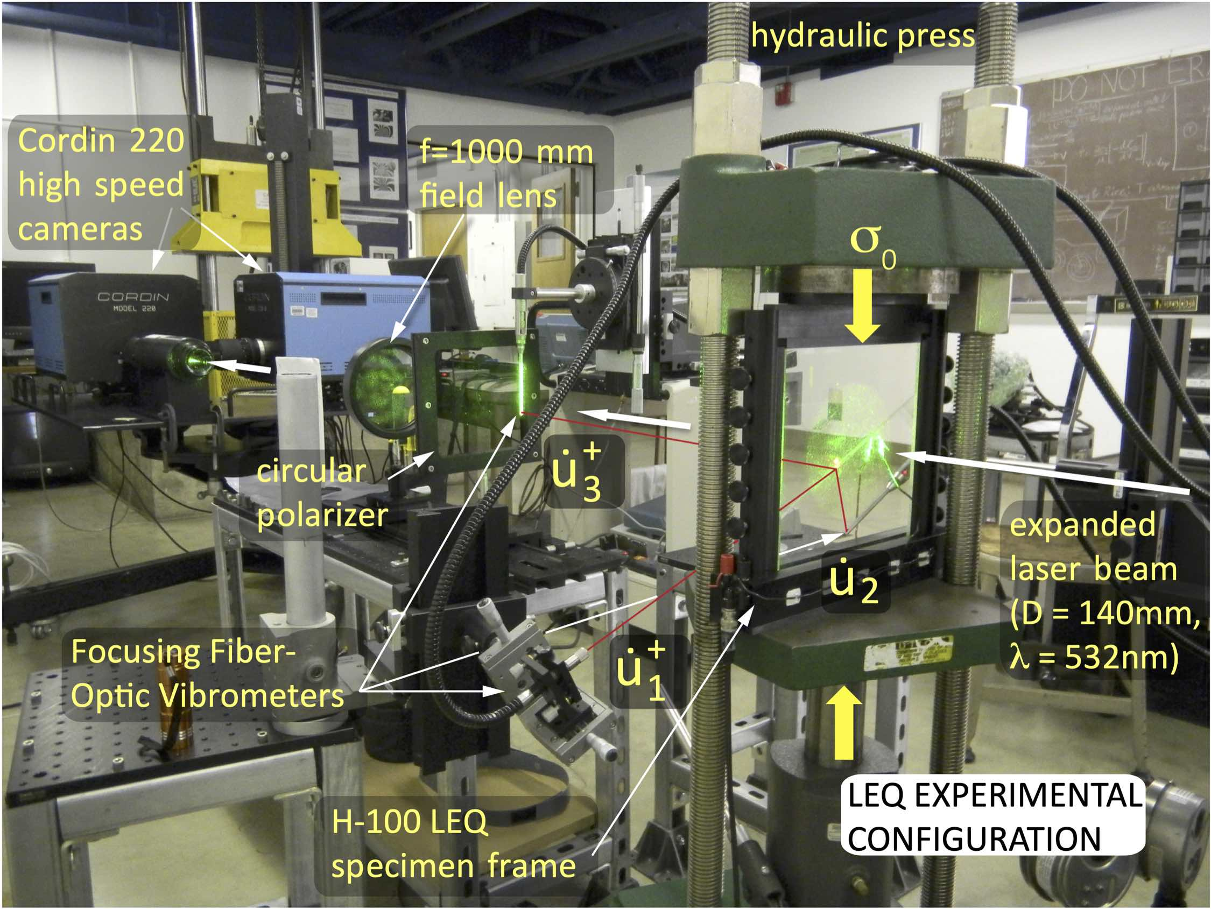
Experiments

Slide 28
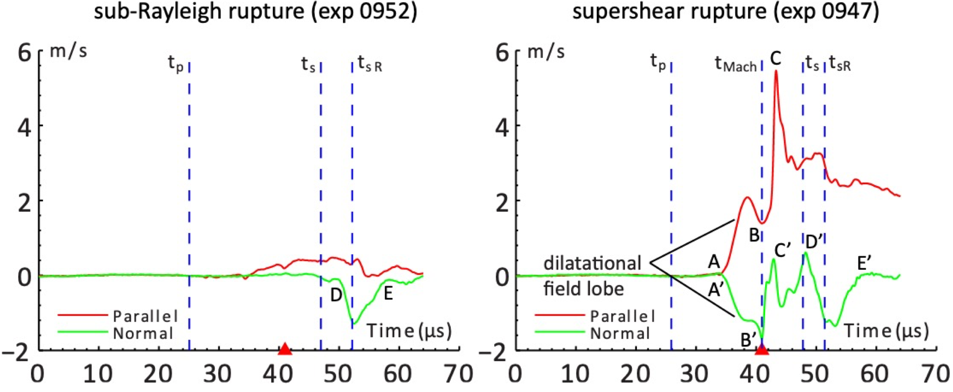
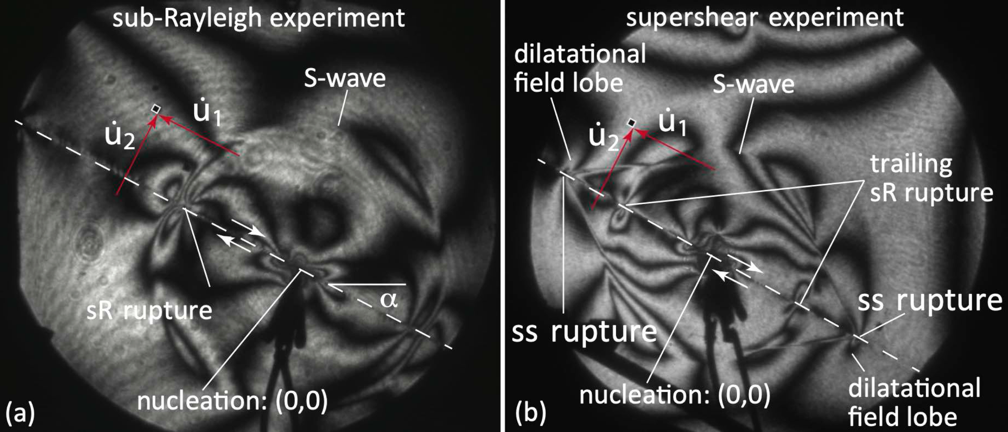
Experiments
Mello, Bhat et al. (2010, 2016) : Experimental Validation of Ground Motion Signatures of Supershear Earthquakes
Fault Parallel Motion > Fault Normal Motion for Supershear ruptures
Supershear rupture front is followed by a "Trailing Rayleigh Rupture"

Slide 29
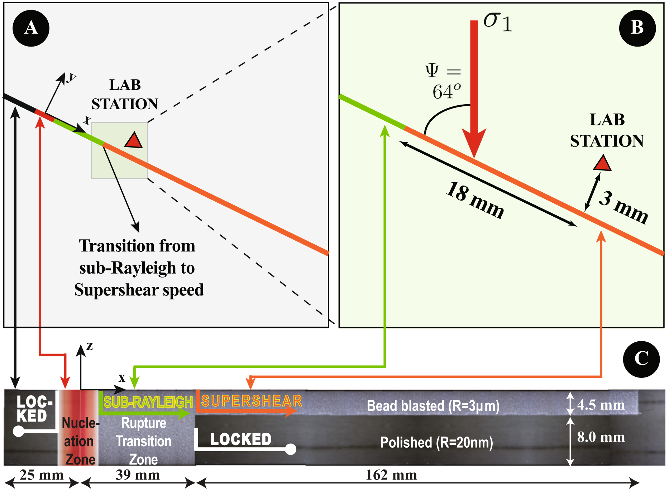
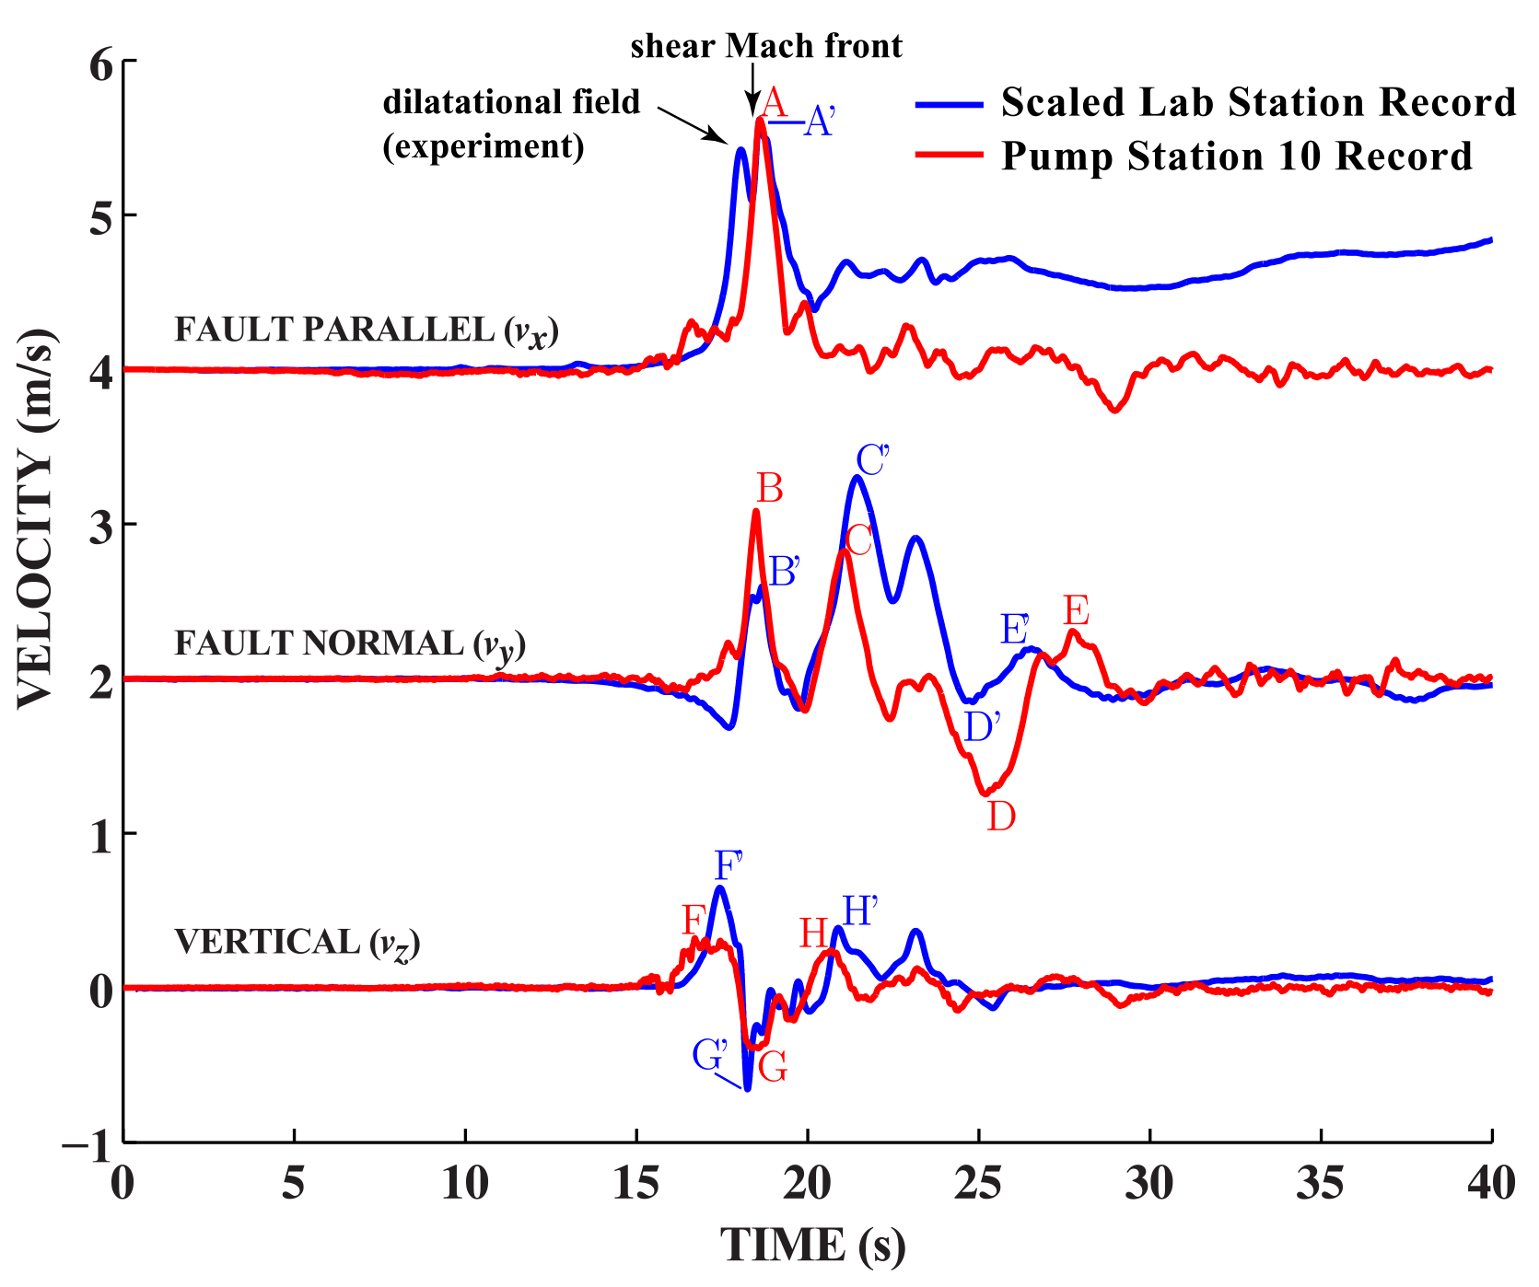
Experiments
Mello, Bhat et al. (2014) : Scaled Reproduction of the 2002 Denali, Alaska Supershear Earthquake

Slide 30
Experiments
Mello (2012, PhD Thesis) : Transition to Supershear Rupture Speed
Very Rare Mother-Daughter Transition Observed

Slide 31
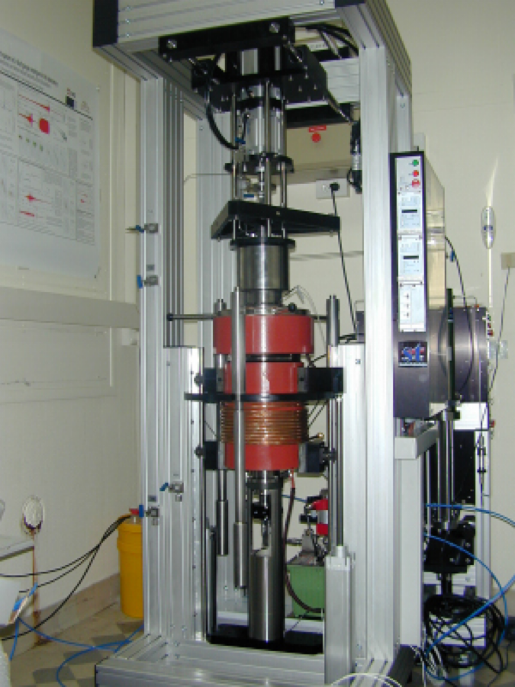
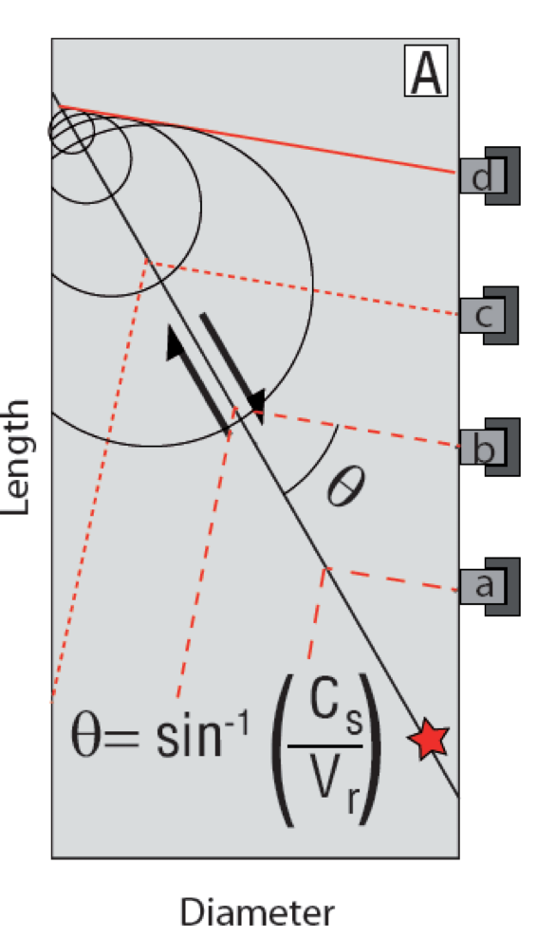
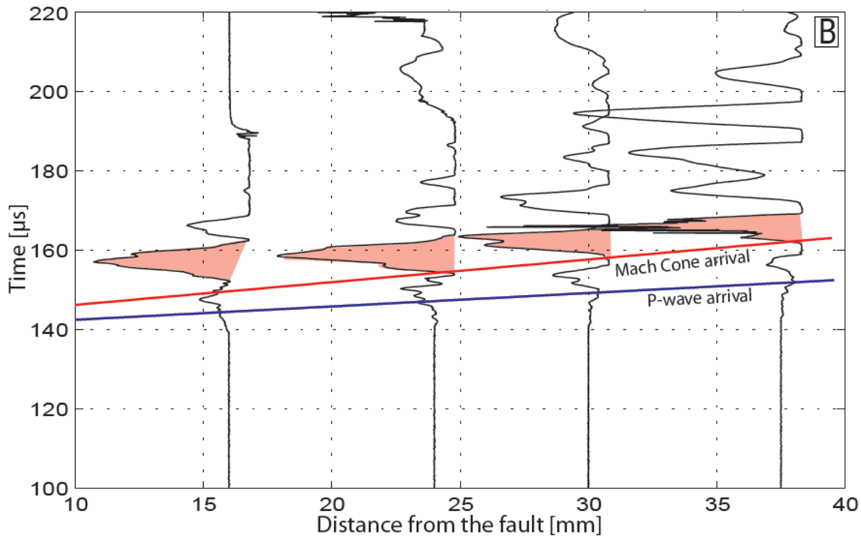
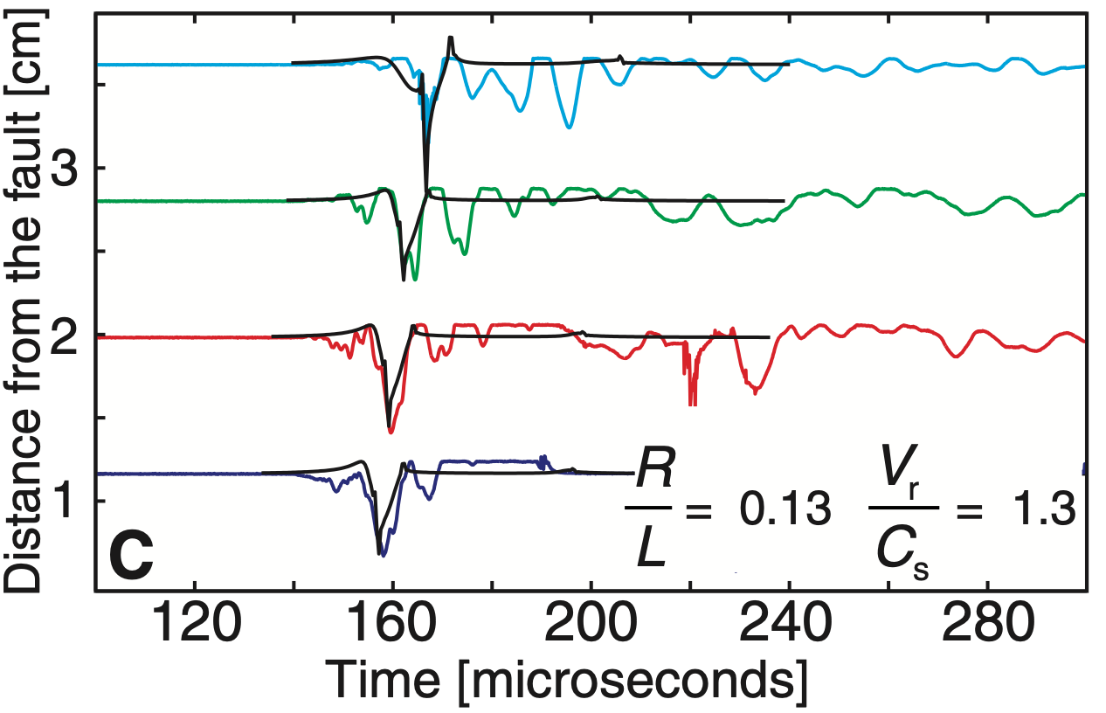
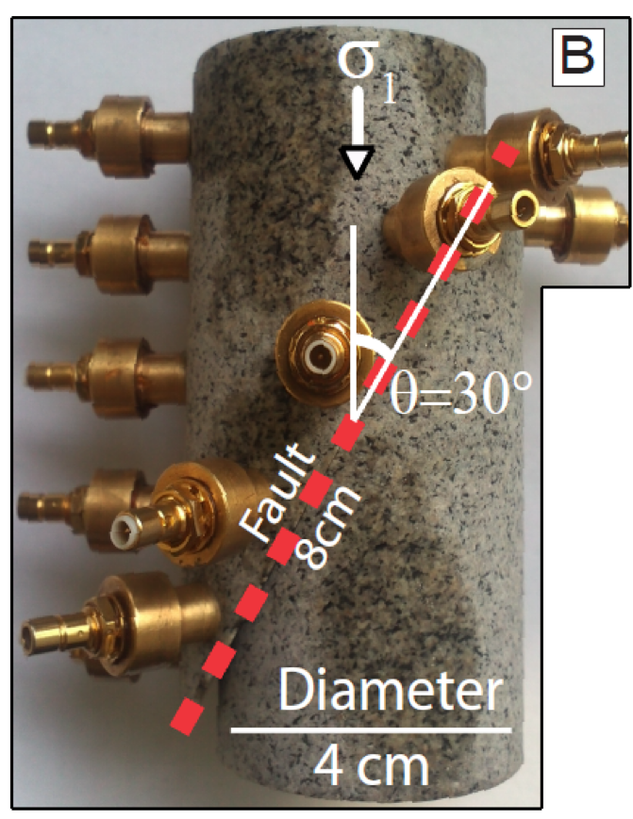
Experiments
Passelégue et al. (2013) : Experimental Evidence of Supershear Rupture Speed in Rocks

Slide 32
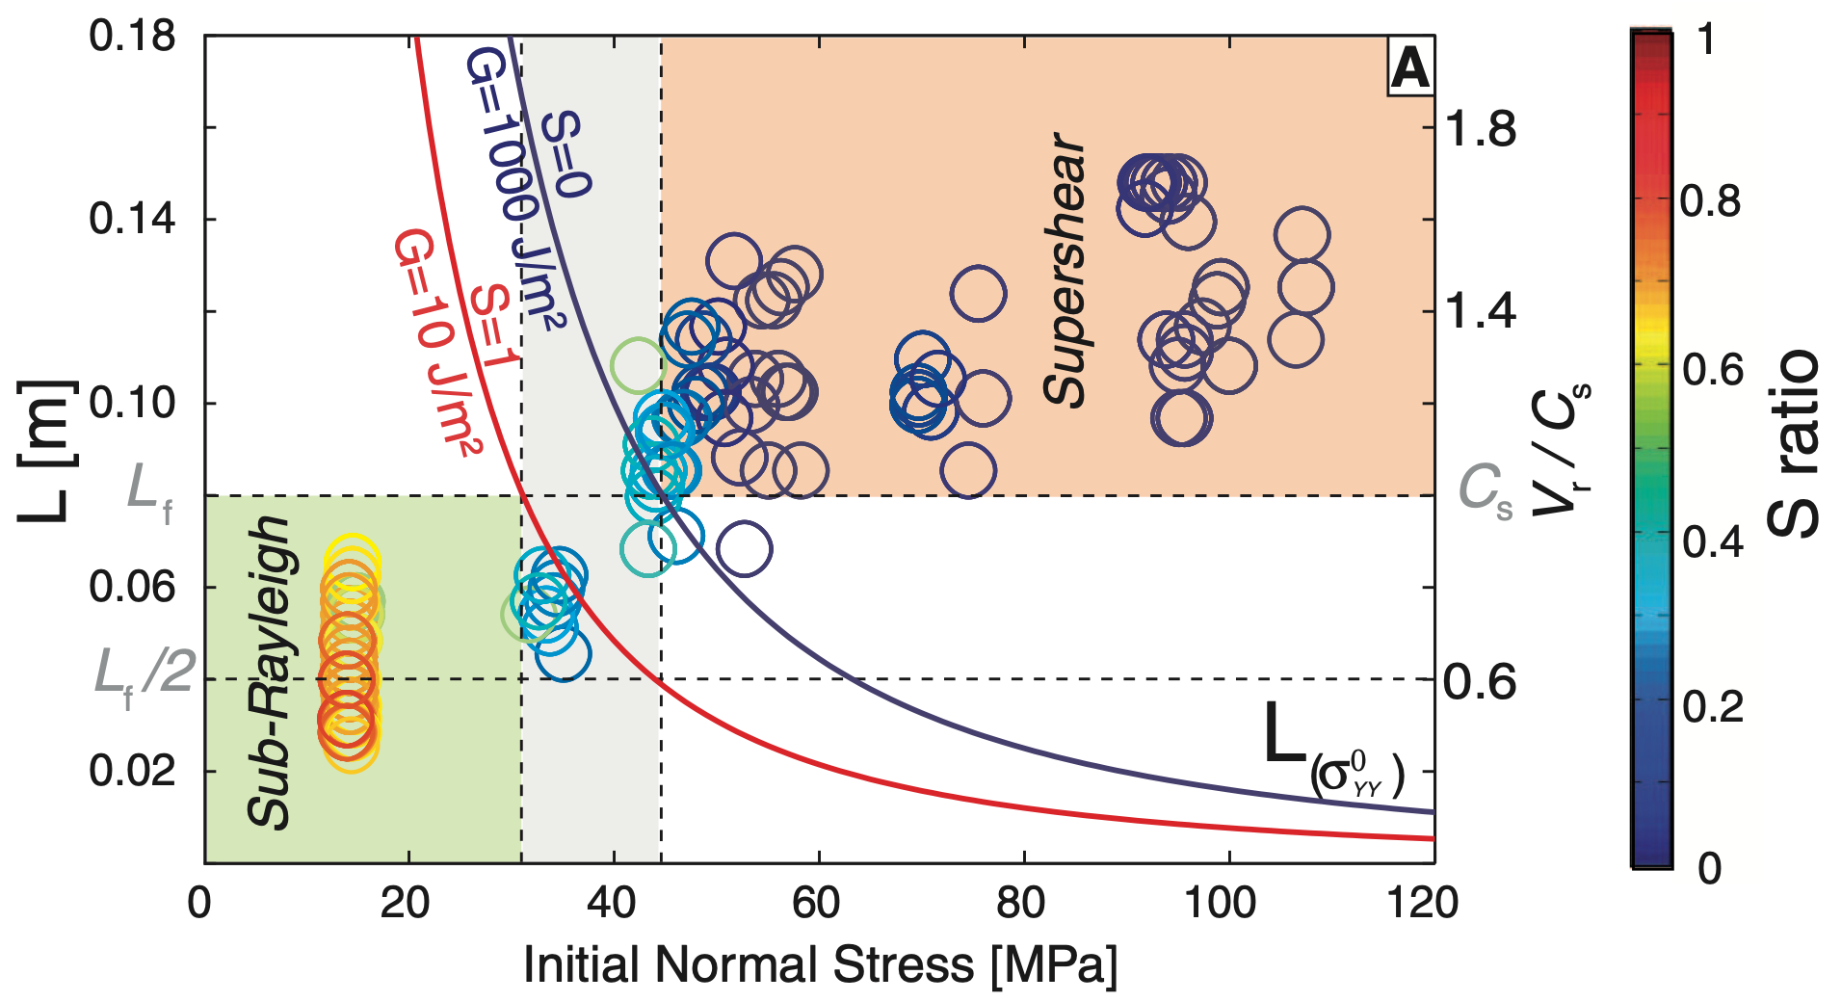
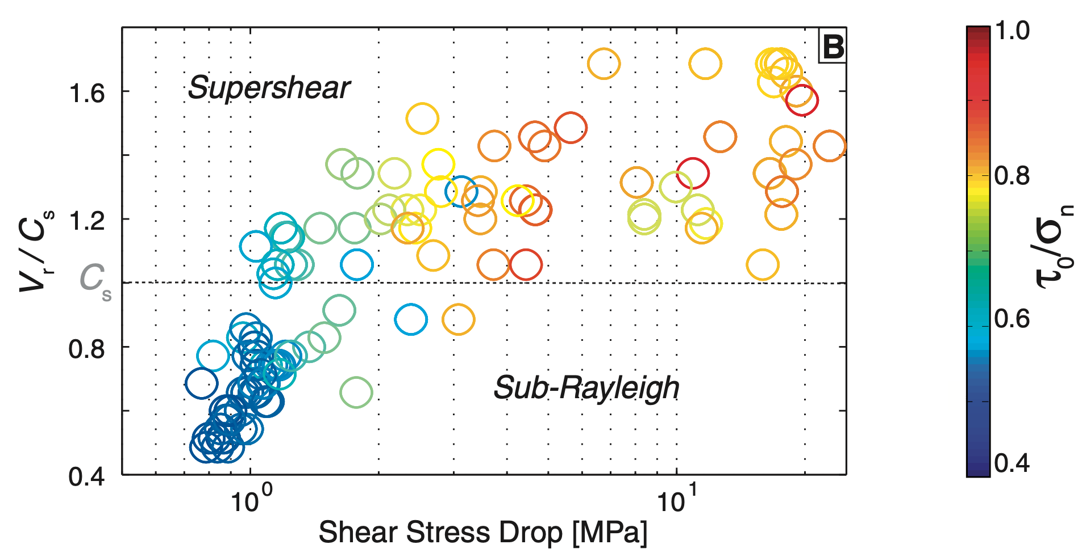
Experiments
Passelégue et al. (2013) : Experimental Evidence of Supershear Rupture Speed in Rocks
Supershear ruptures possible under crustal conditions and in rocks
Transition to Supershear speed requires:
S < 1.77 (1.19 in 3D) Andrews 1976, Das & Aki 1977, Dunham 2007
Fault Length > Transition Length, L

Slide 33
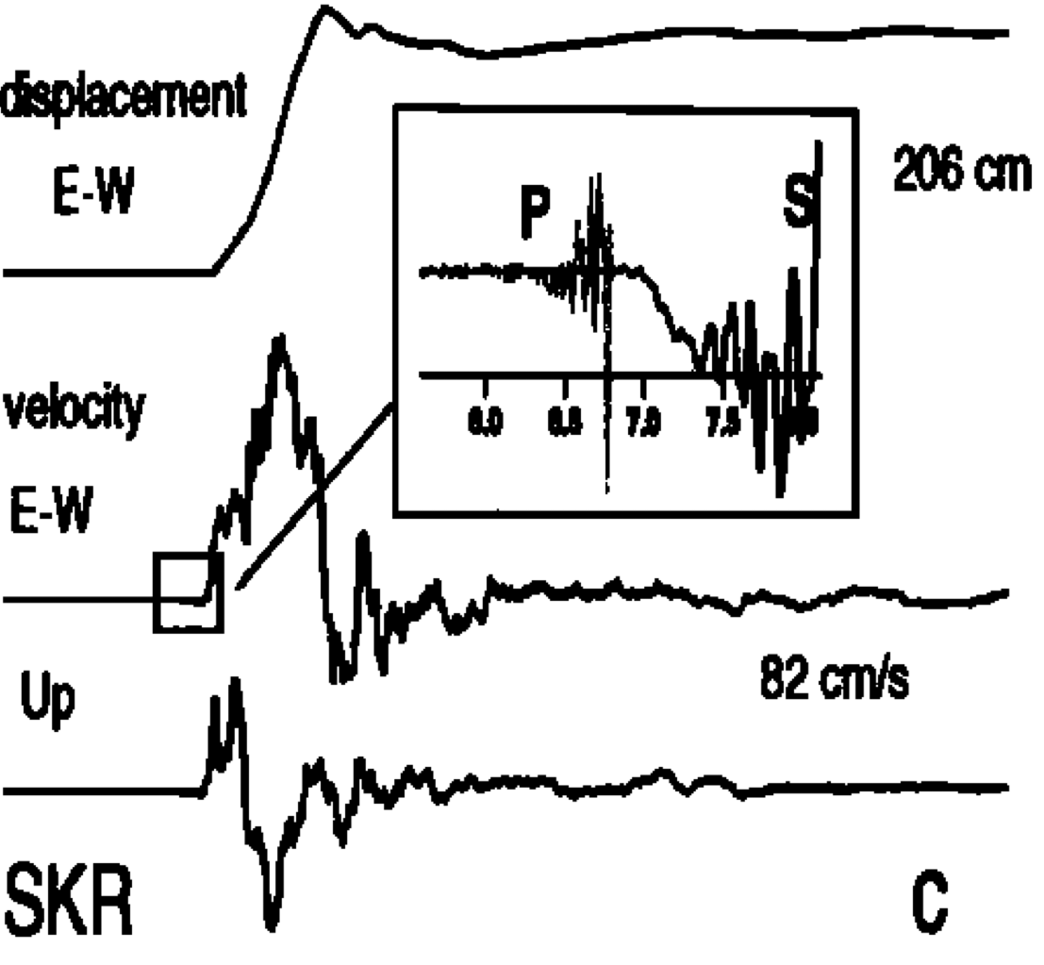
Observations
Supershear earthquakes in the wild
Olson & Apsel (1982), Archuleta (1984) and Spudich & Cranswick (1984) : 1979 Mw 6.5 Imperial Valley earthquake
This was not universally accepted and the scale tipped in the favour of supershear skeptics for more than 25 years (Das, 2015)
Bouchon et al (2000, 2001) : 1999 Mw 7.5 Izmit & Mw 7.1 Düzce earthquakes

Slide 34
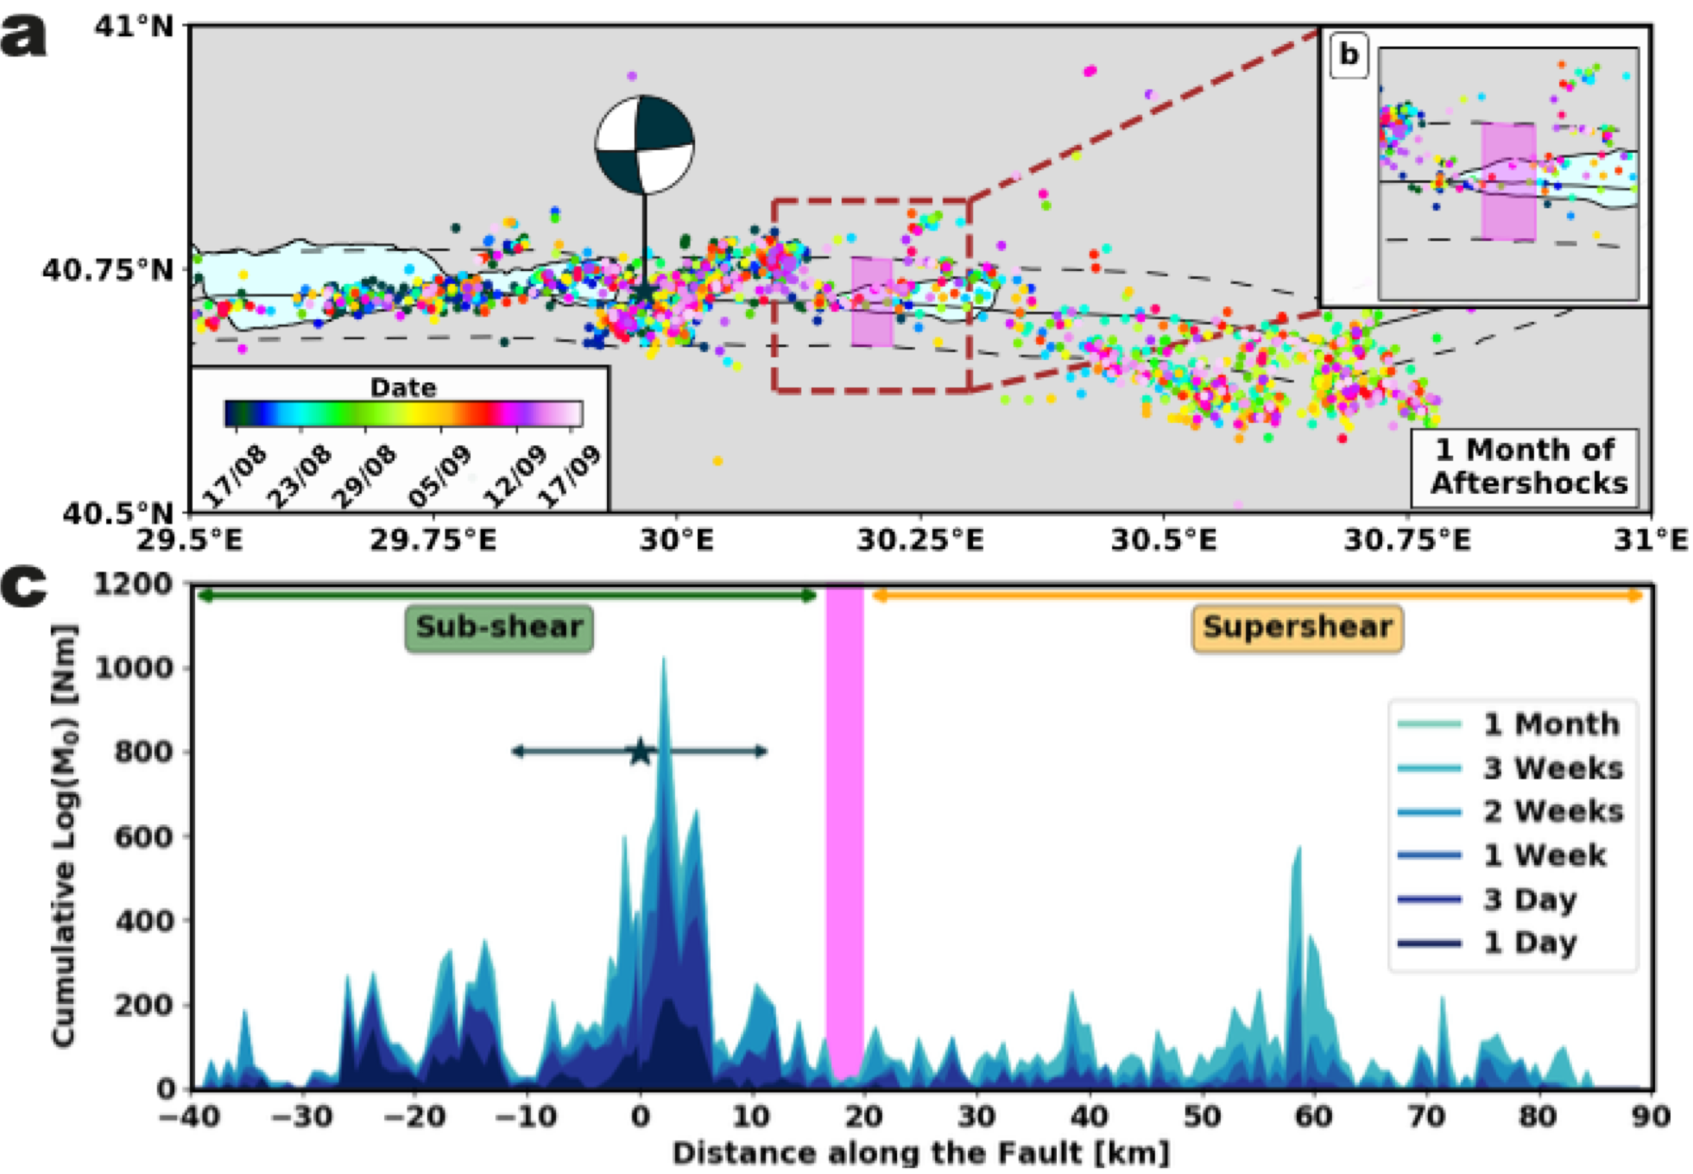
Observations
Supershear earthquakes in the wild
Bouchon et al (2000, 2001) : 1999 Mw 7.5 Izmit & Mw 7.1 Düzce earthquakes
Subshear
Transition
Supershear
Transition
Supershear
Subshear
Supershear
Subshear
Transition
Jara, Bruhat et al. 2021

Slide 35
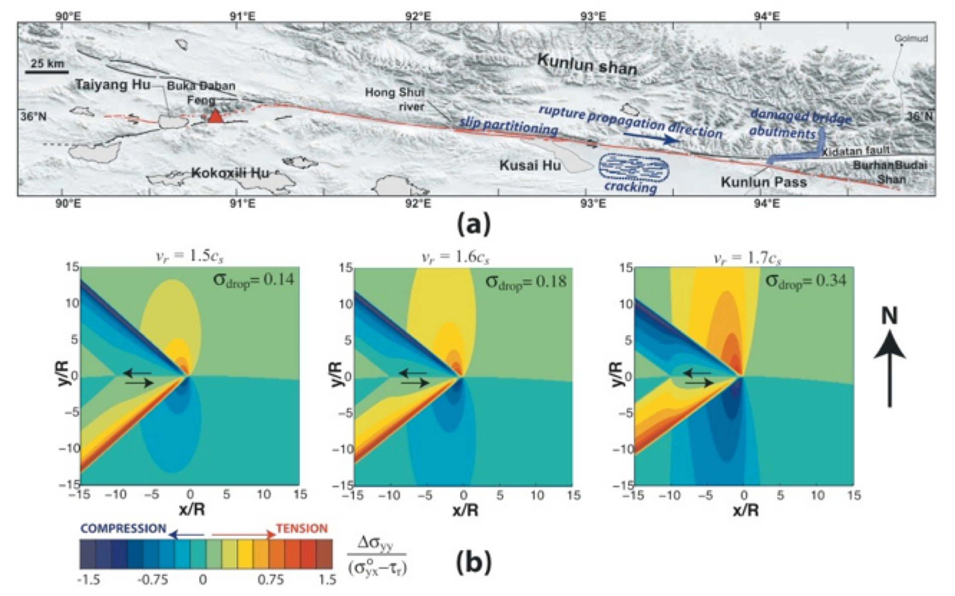
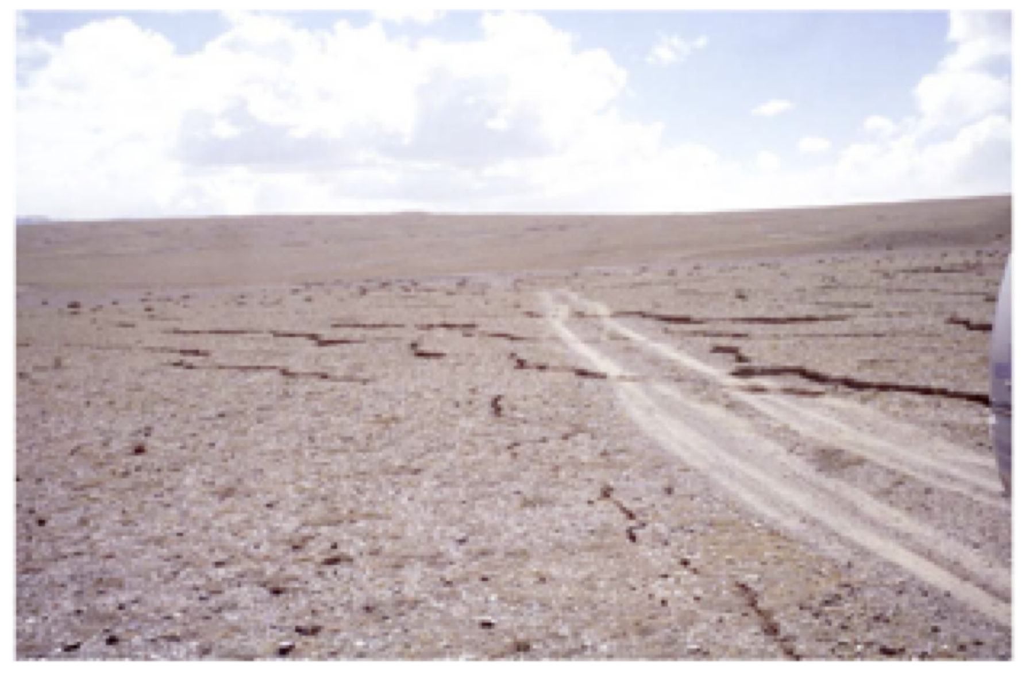
Observations
Supershear earthquakes in the wild
Bouchon & Vallée (2003) Robinson et al (2006) & others : 2001 Mw 7.8 Kunlun, Tibet earthquake
Bhat et al. 2007

Slide 36
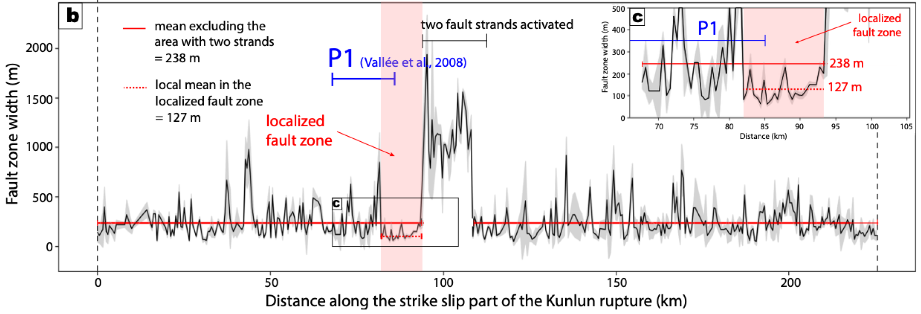
Observations
Supershear earthquakes in the wild
Bouchon & Vallée (2003) Robinson et al (2006) & others : 2001 Mw 7.8 Kunlun, Tibet earthquake
Subshear
Transition
Supershear
Transition
Supershear
Subshear
Supershear
Subshear
Transition
Jara, Bruhat et al. 2021
Jara et al to be subm.

Slide 37
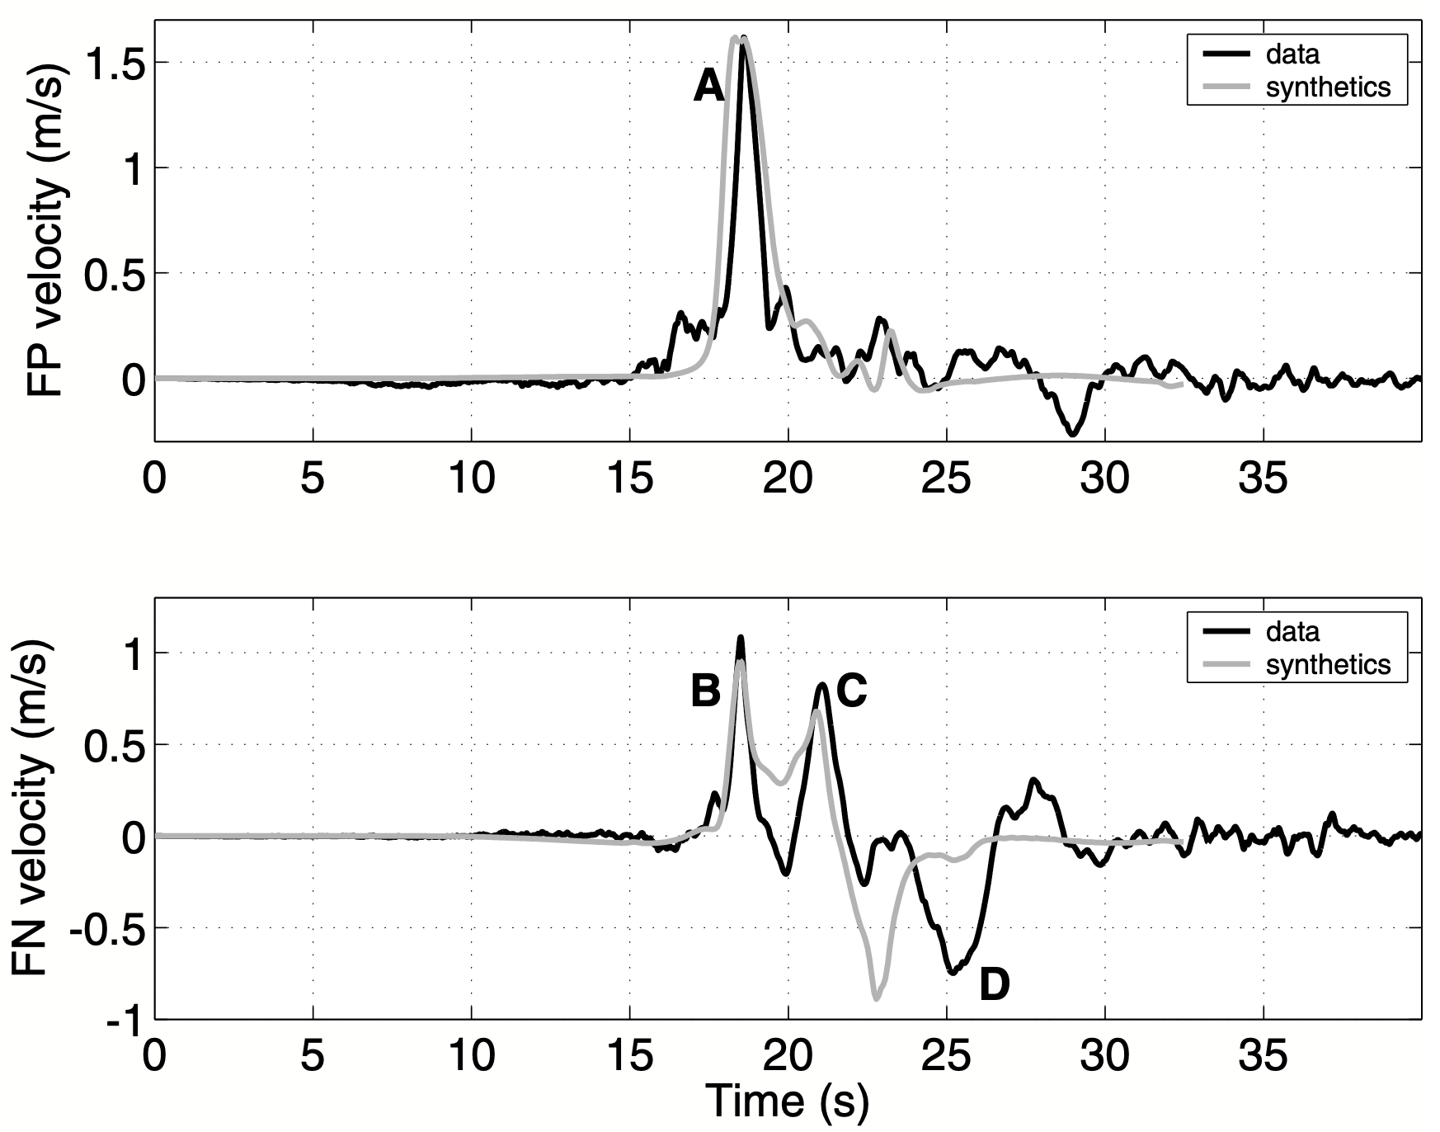
Observations
Supershear earthquakes in the wild
Dunham & Archuleta (2004) Ellsworth et al. (2004) & others : 2002 Mw 7.8 Denali earthquake
Mello, Bhat et al. 2014

Slide 38
Observations
Supershear earthquakes in the wild
Yue et al (2013): 2013 Mw 7.5 Craig, Alaska earthquake
Zhan et al (2014) : 2013 Mw 6.7 Okhotsk, Kamtchatka earthquake. Deepest and fastest earthquake recorded
Bao et al (2019) Socquet et al (2019) Amlani et al (2021): 2018 Mw 7.5 Palu, Sulawesi earthquake

Slide 39
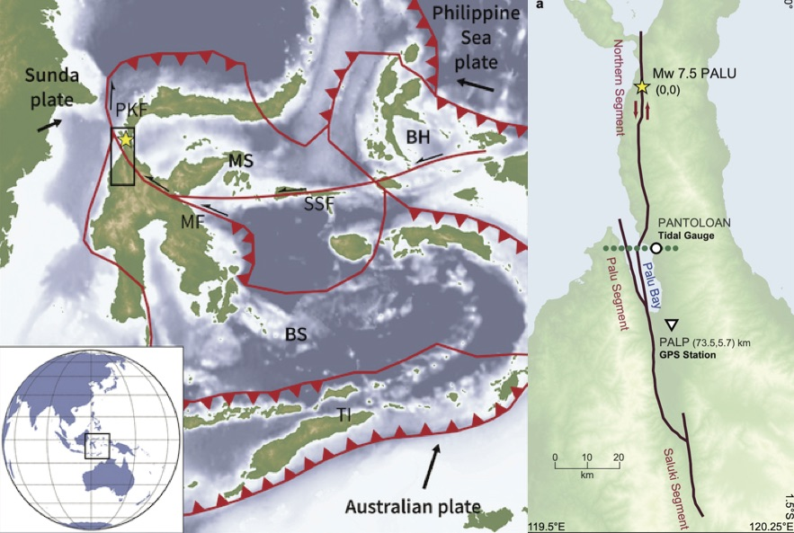
Observations
Supershear earthquakes in the wild
Bao et al (2019) Socquet et al (2019) Amlani et al (2021): 2018 Mw 7.5 Palu, Sulawesi earthquake
Ulrich et al. 2019
Amlani et al. 2021

Slide 40
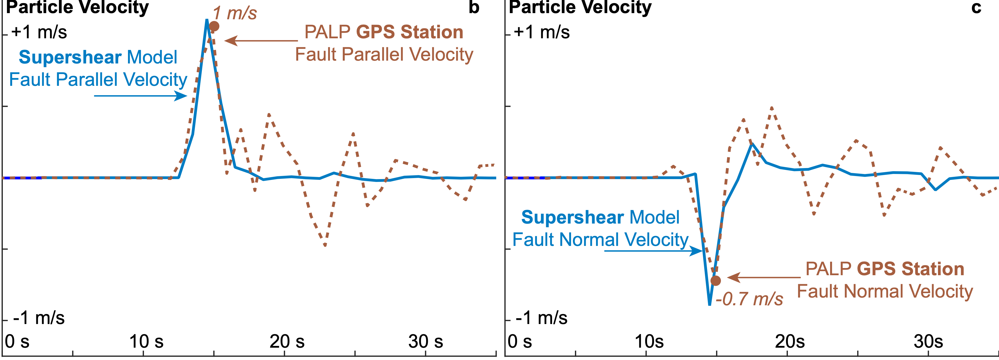
Observations
Supershear earthquakes in the wild
Amlani et al. (2021) : First observation of Supershear Earthquake on a GPS station

Slide 41
indubitably
Dynamic shear ruptures, including earthquakes, can indubitably attain supershear speeds
attain supershear speeds
Supershear ruptures are stable above the Eshelby speed, $\sqrt{2}c_{s}$
The near field particle velocity is dominated by the fault parallel component for such ruptures. The opposite is true for sub-Rayleigh/ sub-shear ruptures.
There is a clear separation of the dilatational and the shear fields which manifest in the ground motion.
Supershear ruptures are, usually, trailed by a pulse traveling exactly at the Rayleigh wave speed. This pulse has dominantly fault normal motion.
In 3D, supershear ruptures manifest Rayleigh Mach fronts, in addition to the shear ones. The Rayleigh Mach fronts suffer no attenuation with distance from the fault for an ideal medium.
At the location of transition from sub to supershear speeds, severe Lorentz-like contraction of the stress field should lead to minimal off-fault damage.

Slide 42
Education
Post Doctoral Work
Past Employment
Current Position

Slide 43
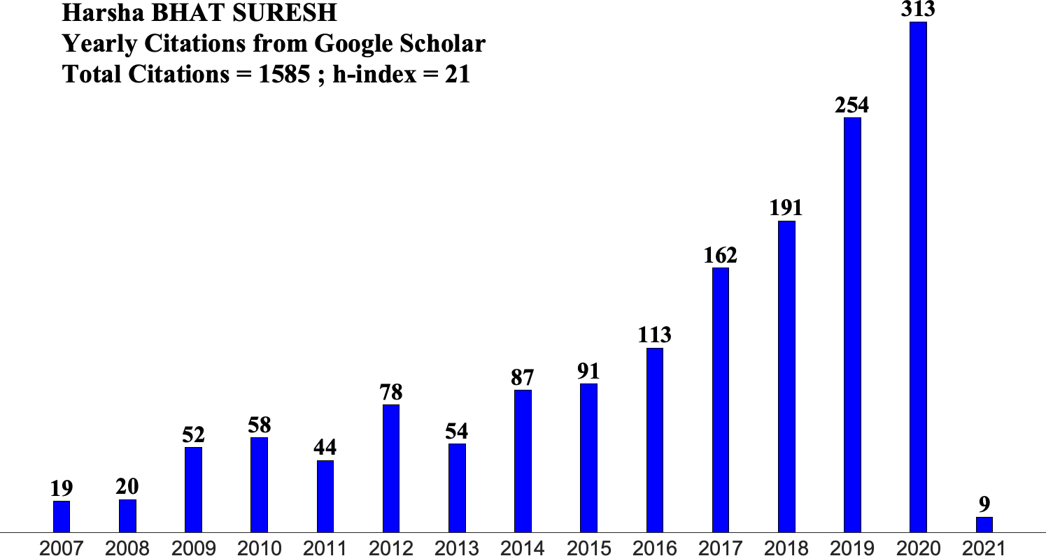
Research Funding & Publications
 | Year | Country | Funding Agency | Status
1 | 2008 | USA | NSF | Accept
2 | 2008 | USA | NSF | Accept
3 | 2010 | USA | NNSA | Accept
4 | 2011 | USA | SCEC | Accept
5 | 2011 | USA | NSF | Reject
6 | 2012 | FRANCE | ANR | Reject
7 | 2013 | FRANCE | ANR | Reject
8 | 2013 | FRANCE | Paris - EMERGENCE | Reject
9 | 2013 | EU | ERC Starting Grant | Reject
10 | 2014 | FRANCE | ANR | Reject
11 | 2013 | EU | ERC Starting Grant | Reject
12 | 2014 | FRANCE | Paris - EMERGENCE | Reject
13 | 2014 | FRANCE | Université Sorbonne Paris Cité | Reject
14 | 2015 | FRANCE | ANR | Reject
15 | 2015 | FRANCE | Paris - EMERGENCE | Reject
16 | 2016 | FRANCE | ANR | Reject
17 | 2016 | FRANCE | INSU | Accept
18 | 2017 | FRANCE | Simone and Cino Del Duca Foundation | Reject
19 | 2017 | FRANCE | INSU Mi-Lourds | Reject
20 | 2017 | FRANCE | ENS-Action Incitatives | Accept
21 | 2017 | FRANCE | Thomas Jefferson Fund | Reject
22 | 2018 | FRANCE | Thomas Jefferson Fund | Reject
23 | 2019 | EU | ERC Consolidator Grant | Accept
24 | 2019 | FRANCE | INSU | Reject
Over 45 publications in peer reviewed international journals including Nature, Nature Communications and Science
Over 30 publications since joining CNRS
1 Book Chapter
2 Edited Volumes

Slide 45
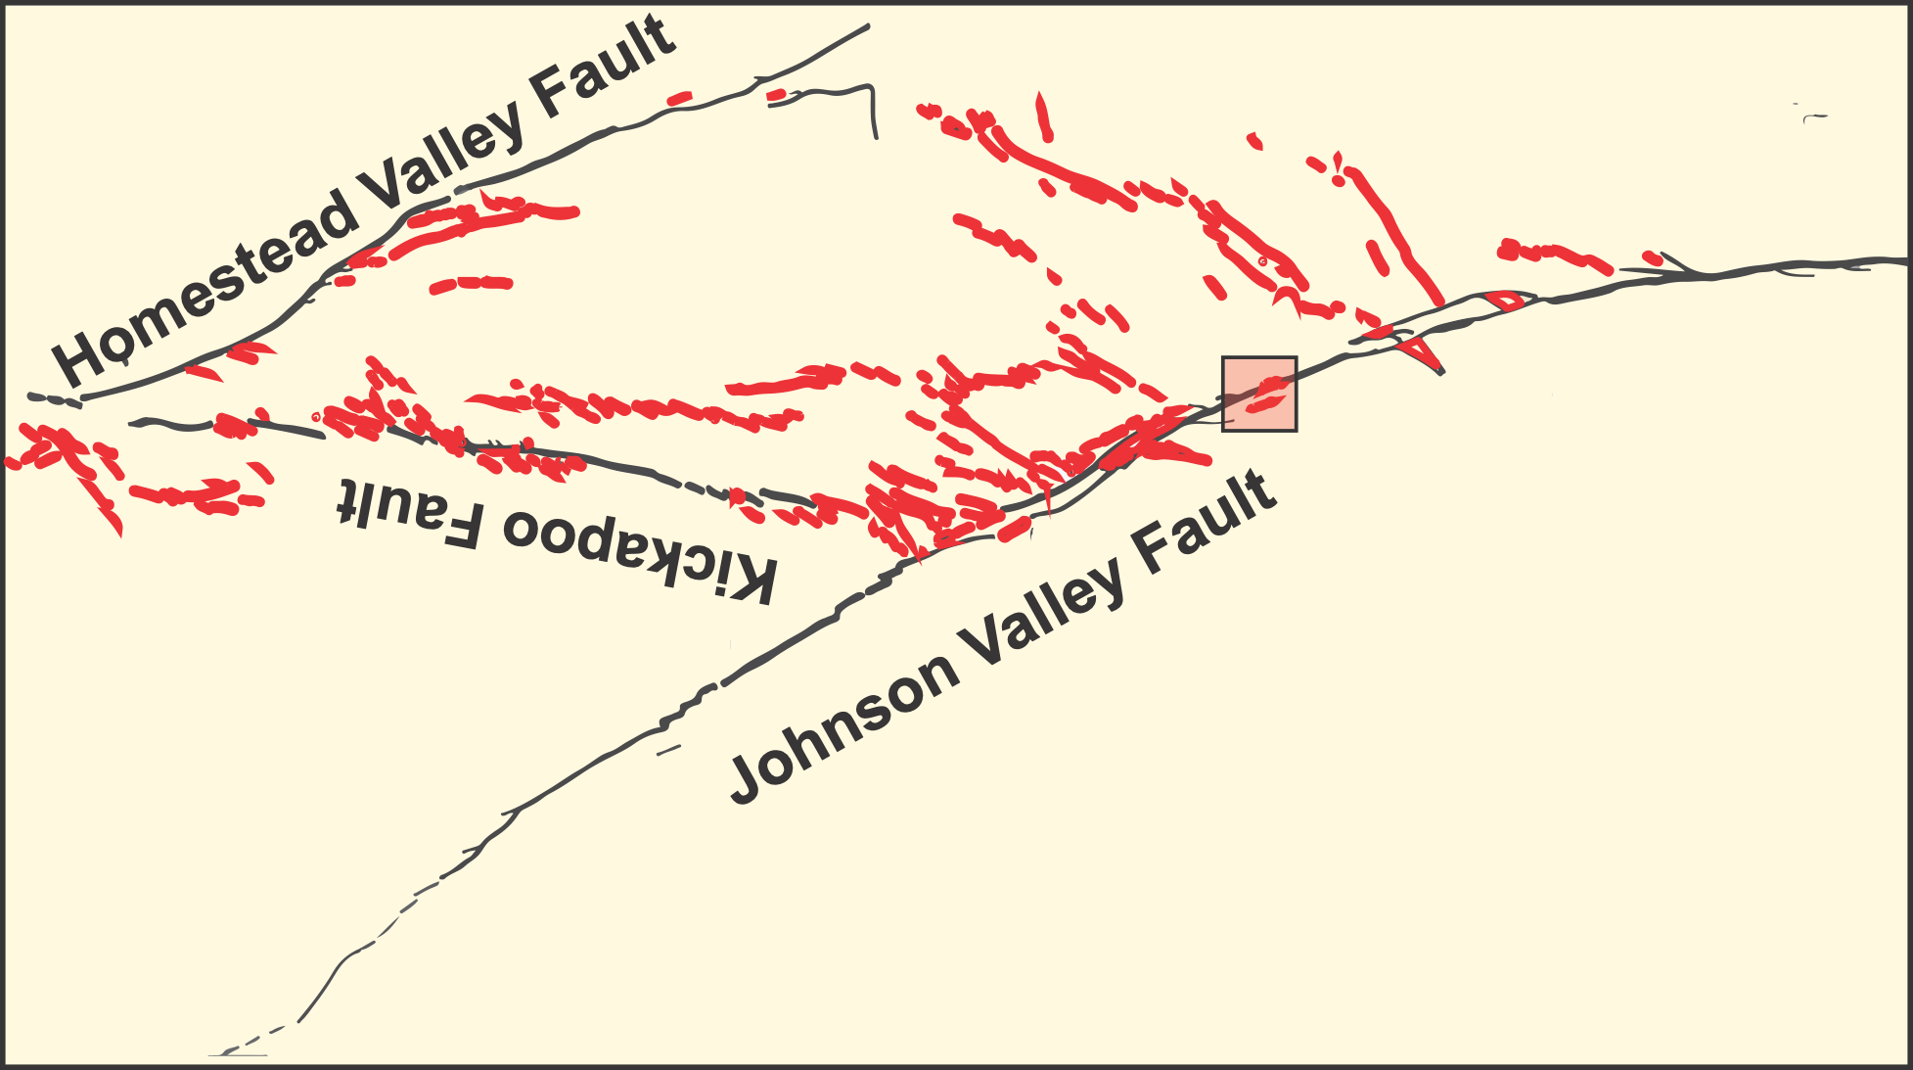
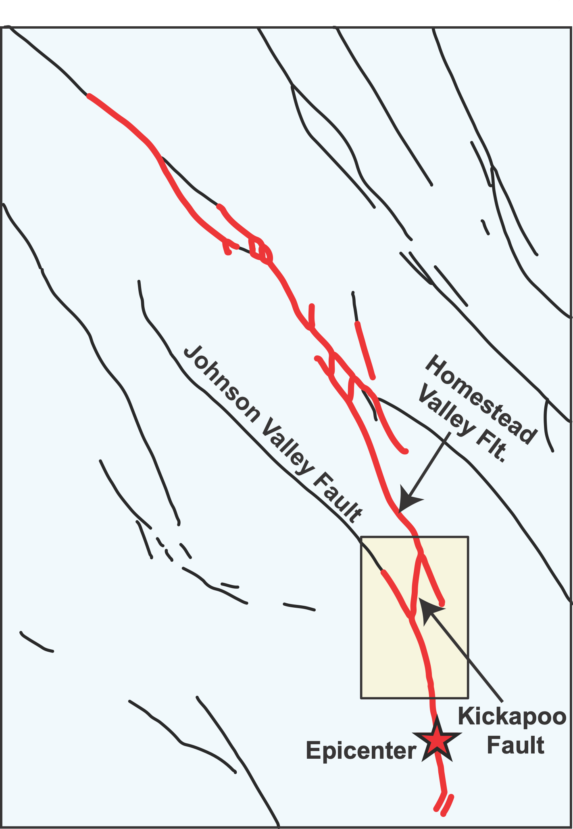
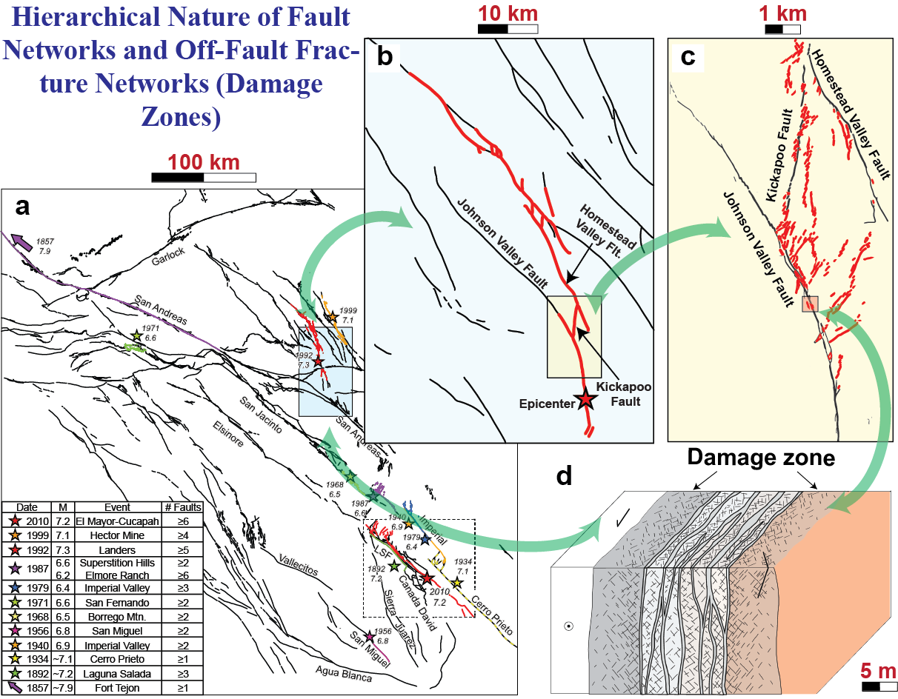
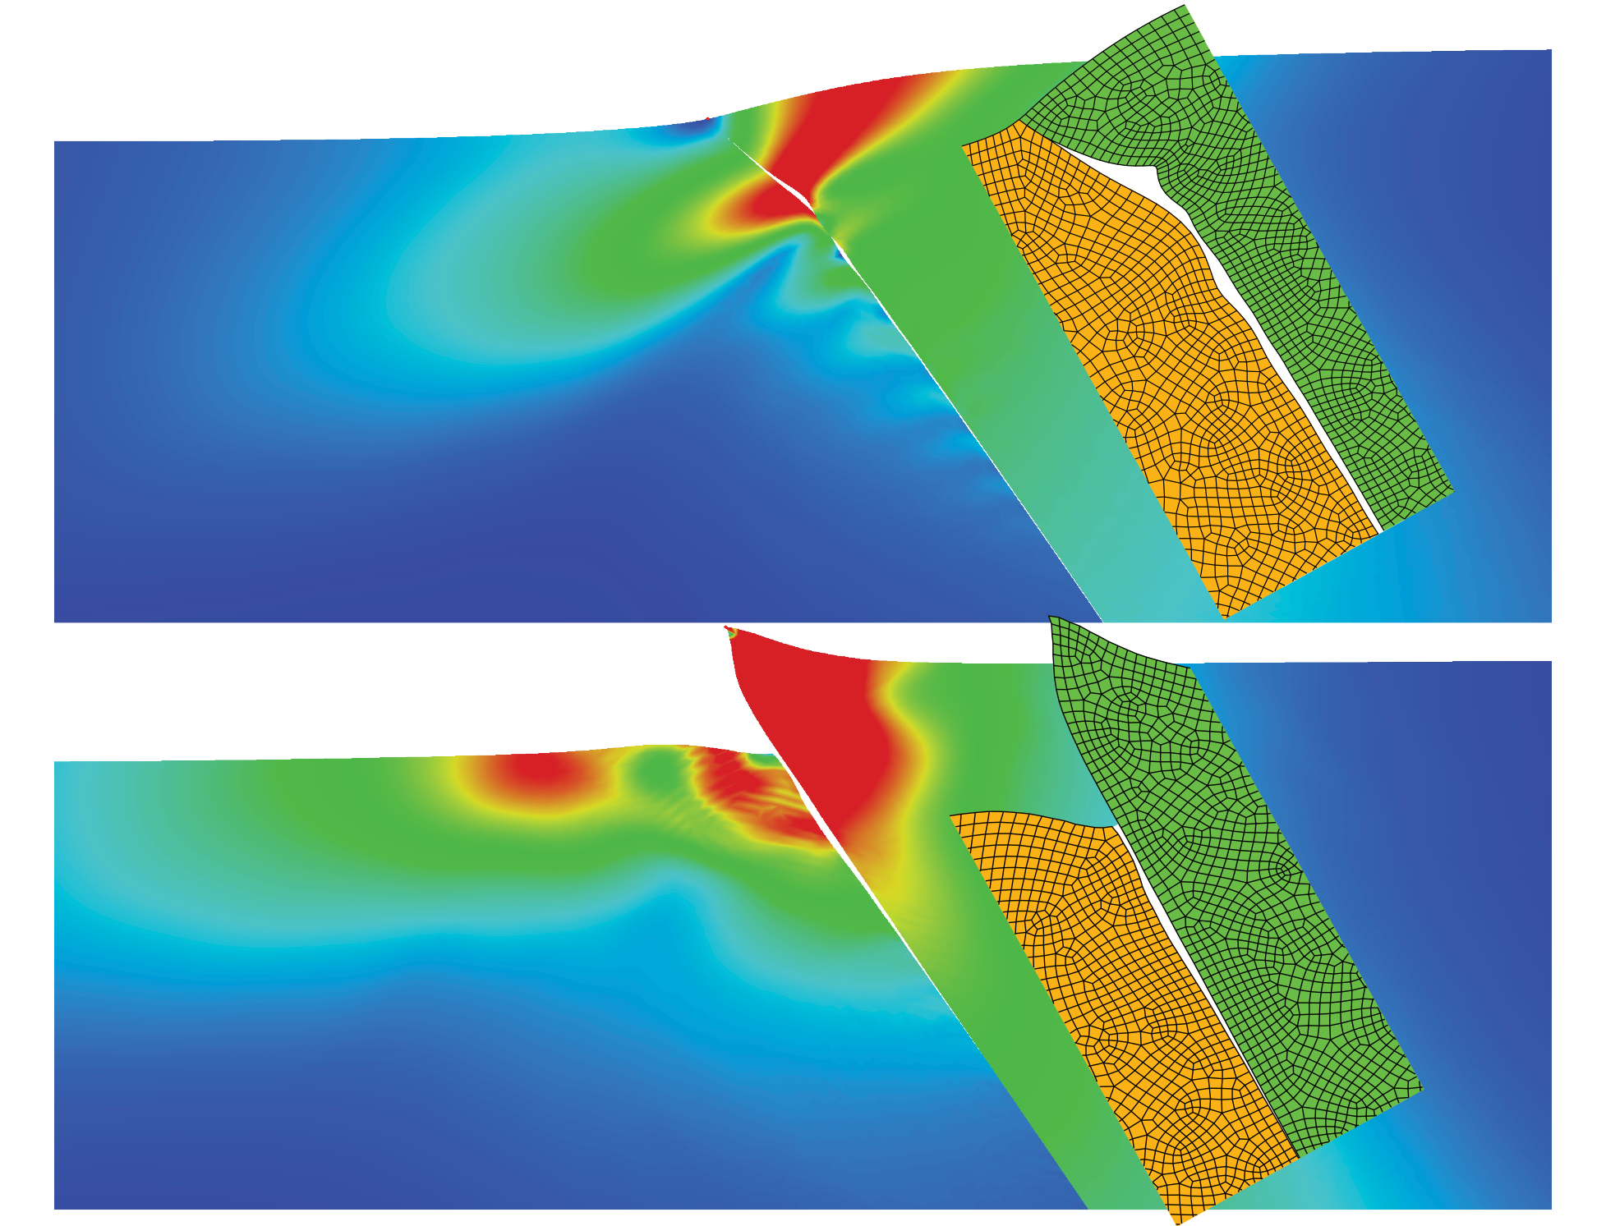
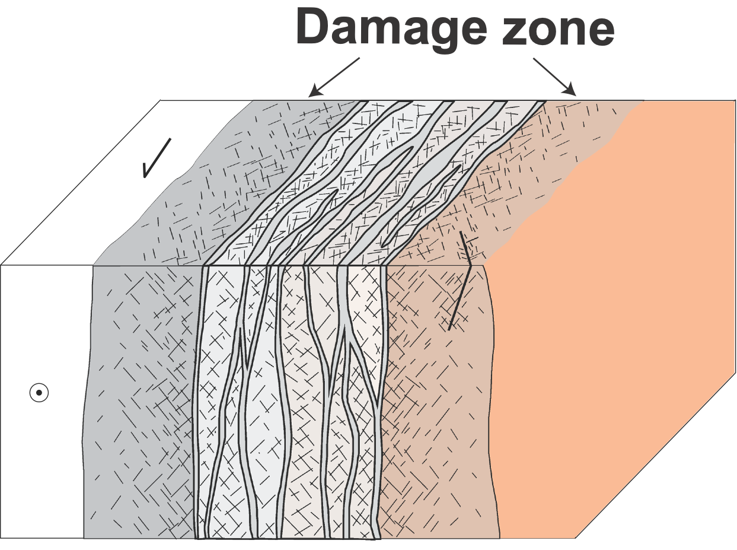
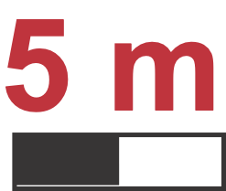
Scientific Contributions
We developed simple rules for rupture branching (forward & backward), in a fault network
We developed new algorithms to model earthquake cycles on realistic fault networks
We showed that slow slip events and earthquakes emerge naturally in non-planar faults
We showed that the off-fault damage dynamically interacts with rupture
We developed micromechanical models of fracture networks for mechanical & hydraulic evolution
We showed that high frequency ground motion emerged from Damage Zone
We co-developed numerical algorithms to spontaneously activate off-fault fracture networks
We were able to explain migration of tremors by non-linear fluid diffusion mechanism
PERSISMO
Jan 2021 - Dec 2025
We showed that thrust faults can actually open

Slide 46
Merci

Slide 47
Thom-Thom & Nana loves you to bits!

